Slide 1



ALPASS
Automated Layout Process Approval and Scrutiny System

Slide 2

Brief process flow of Section 28
Pre-requisites: Registered Applicant and Consultant in the ALPASS Portal
Login with the valid consultant and providing reference of the Applicant
Filling Basic information of the Layout Application and generating Application Number
Submission of Mandatory Documents and Shape file of the Layout, Location and Khasra Plan
Providing Applicant’s consent via Mobile OTP and forwarding Application to Department

Slide 3
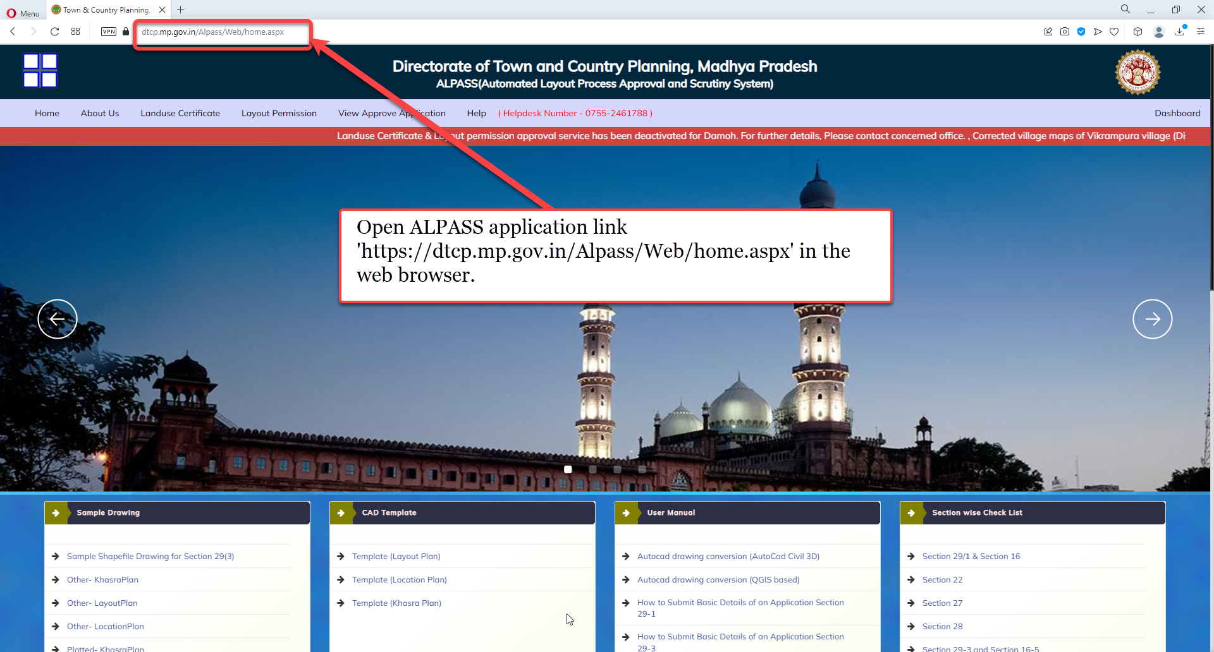
Open ALPASS application link 'https://dtcp.mp.gov.in/Alpass/Web/home.aspx' in the web browser.

Slide 4
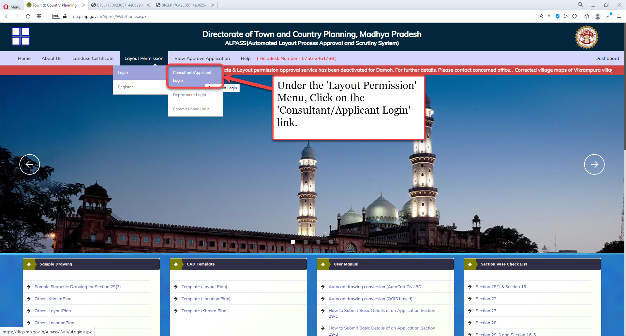
Under the 'Layout Permission' Menu, Click on the 'Consultant/Applicant Login' link.

Slide 5
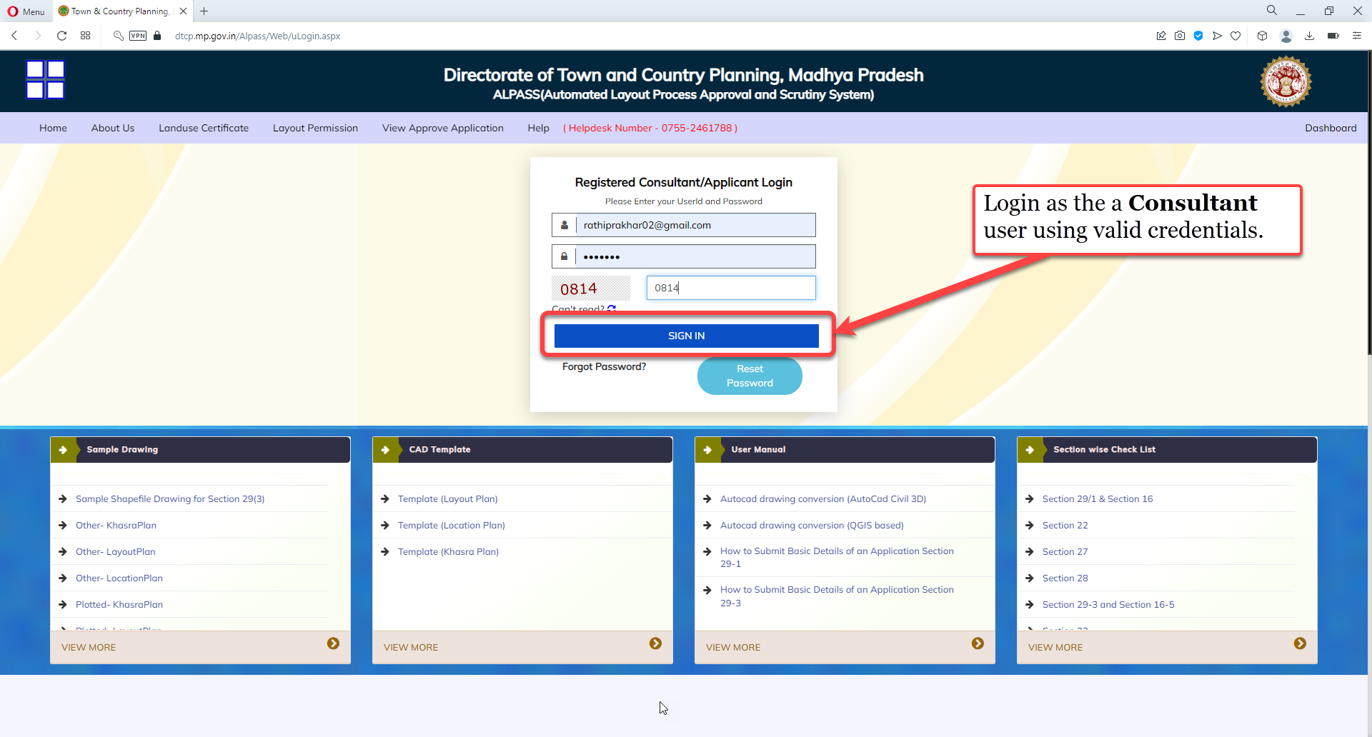
Login as a Consultant user using valid credentials

Slide 6
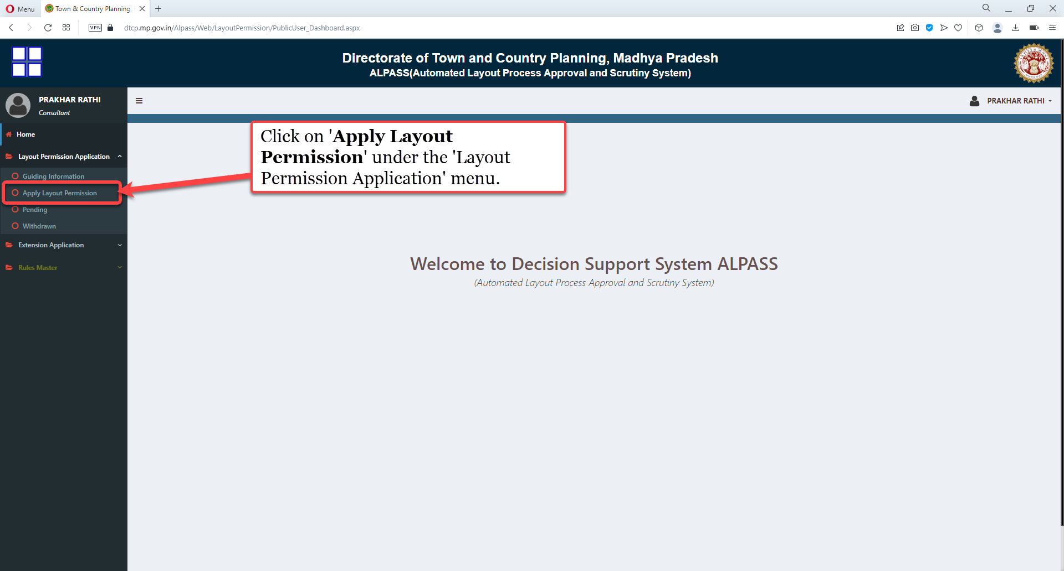
Click on 'Apply Layout Permission' under the 'Layout Permission Application' menu.

Slide 7
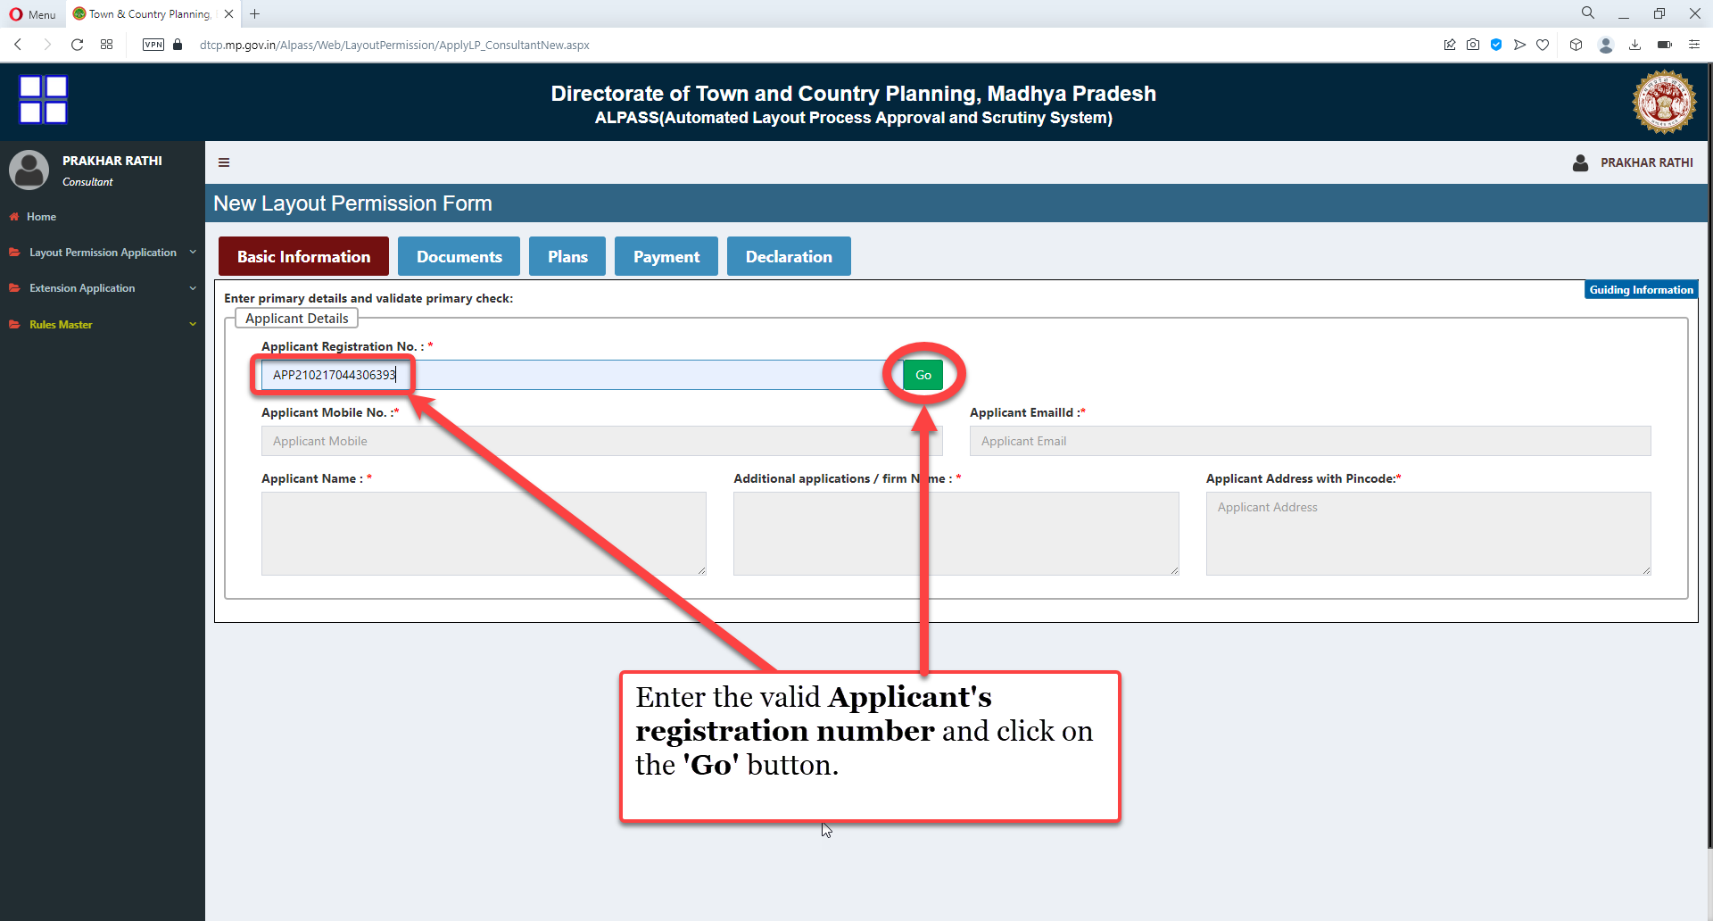
Enter the valid Applicant's registration number and click on the 'Go' button.

Slide 8
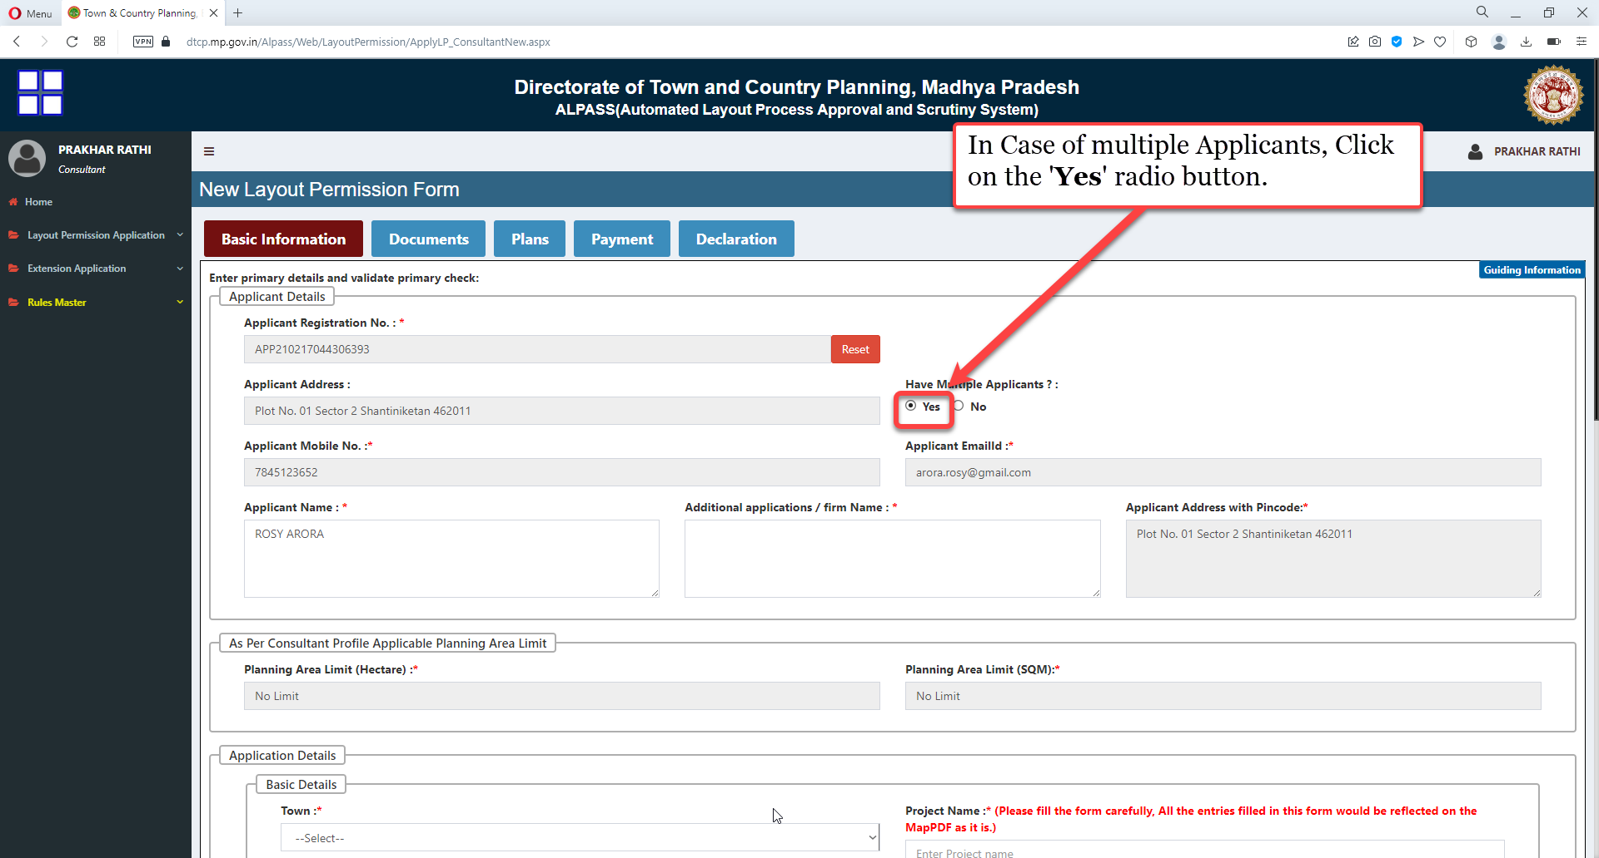
In Case of multiple Applicants, Click on the 'Yes' radio button

Slide 9
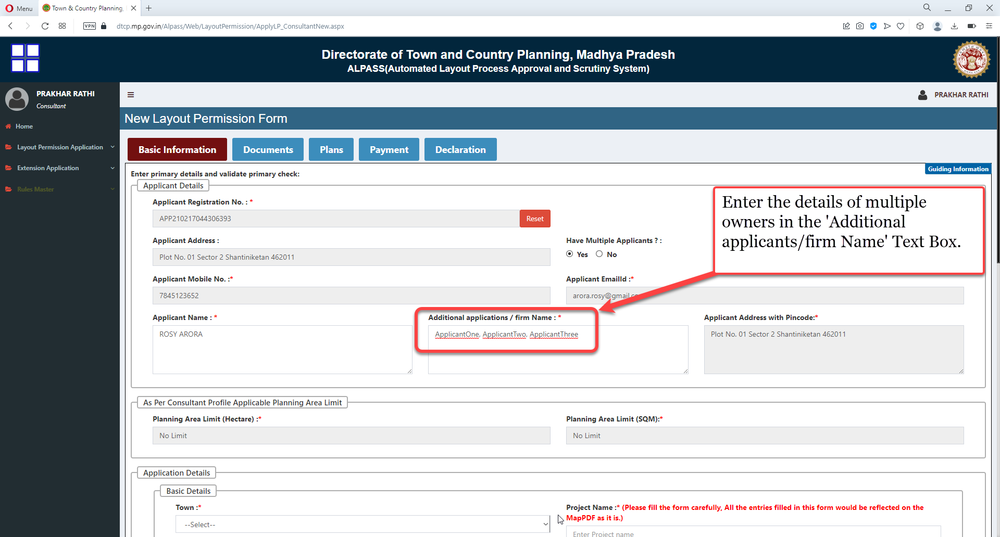
Enter the details of multiple owners in the 'Additional applicants/firm Name' Text Box.

Slide 10
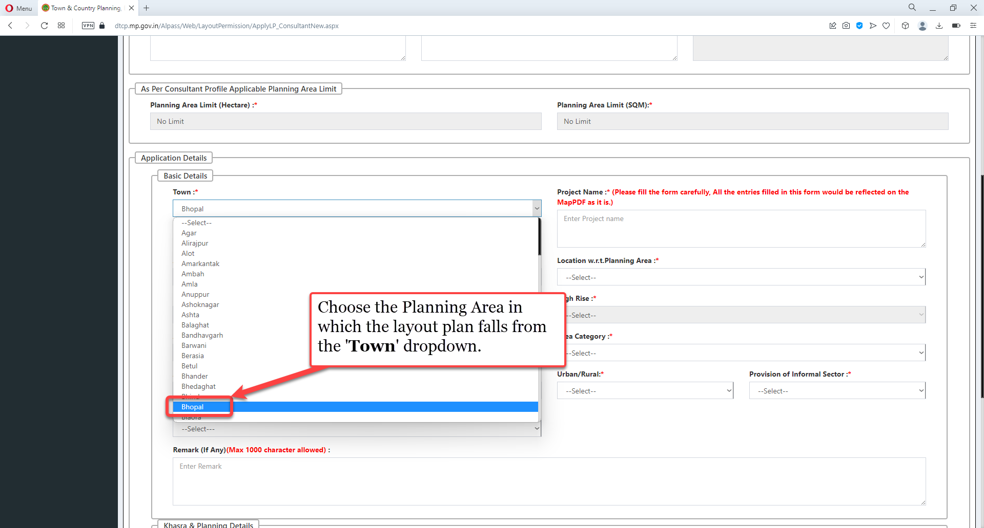
Choose the Planning Area in which the layout plan falls from the 'Town' dropdown.

Slide 11
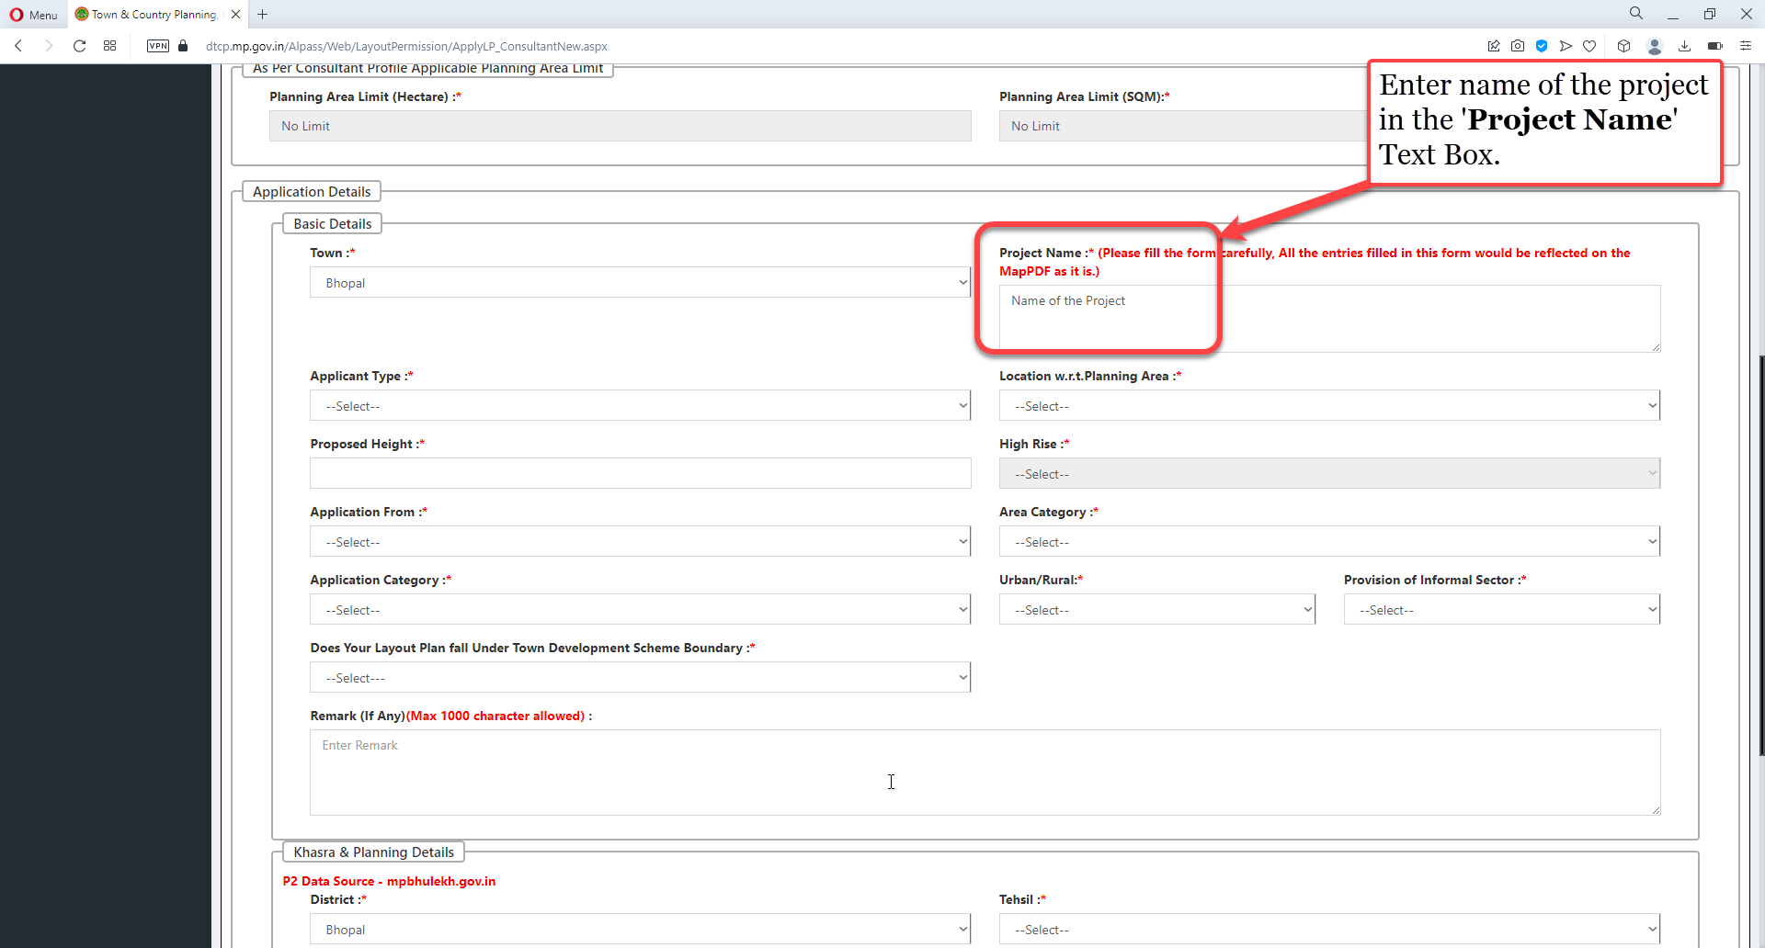
Enter name of the project in the 'Project Name' Text Box.

Slide 12
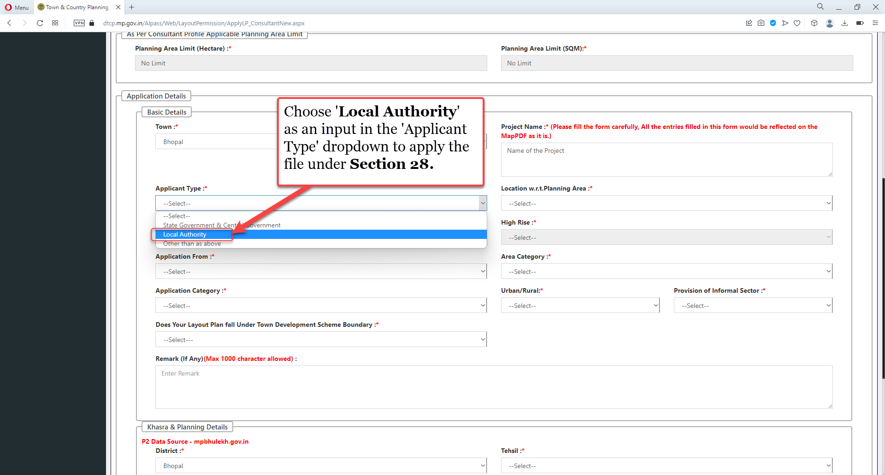
Choose 'Local Authority' as an input in the 'Applicant Type' dropdown to apply the file under Section 28

Slide 13
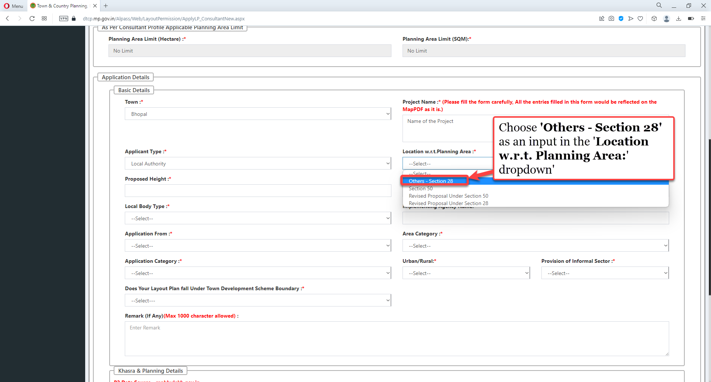
Choose 'Others - Section 28' as an input in the 'Location w.r.t. Planning Area:' dropdown'

Slide 14
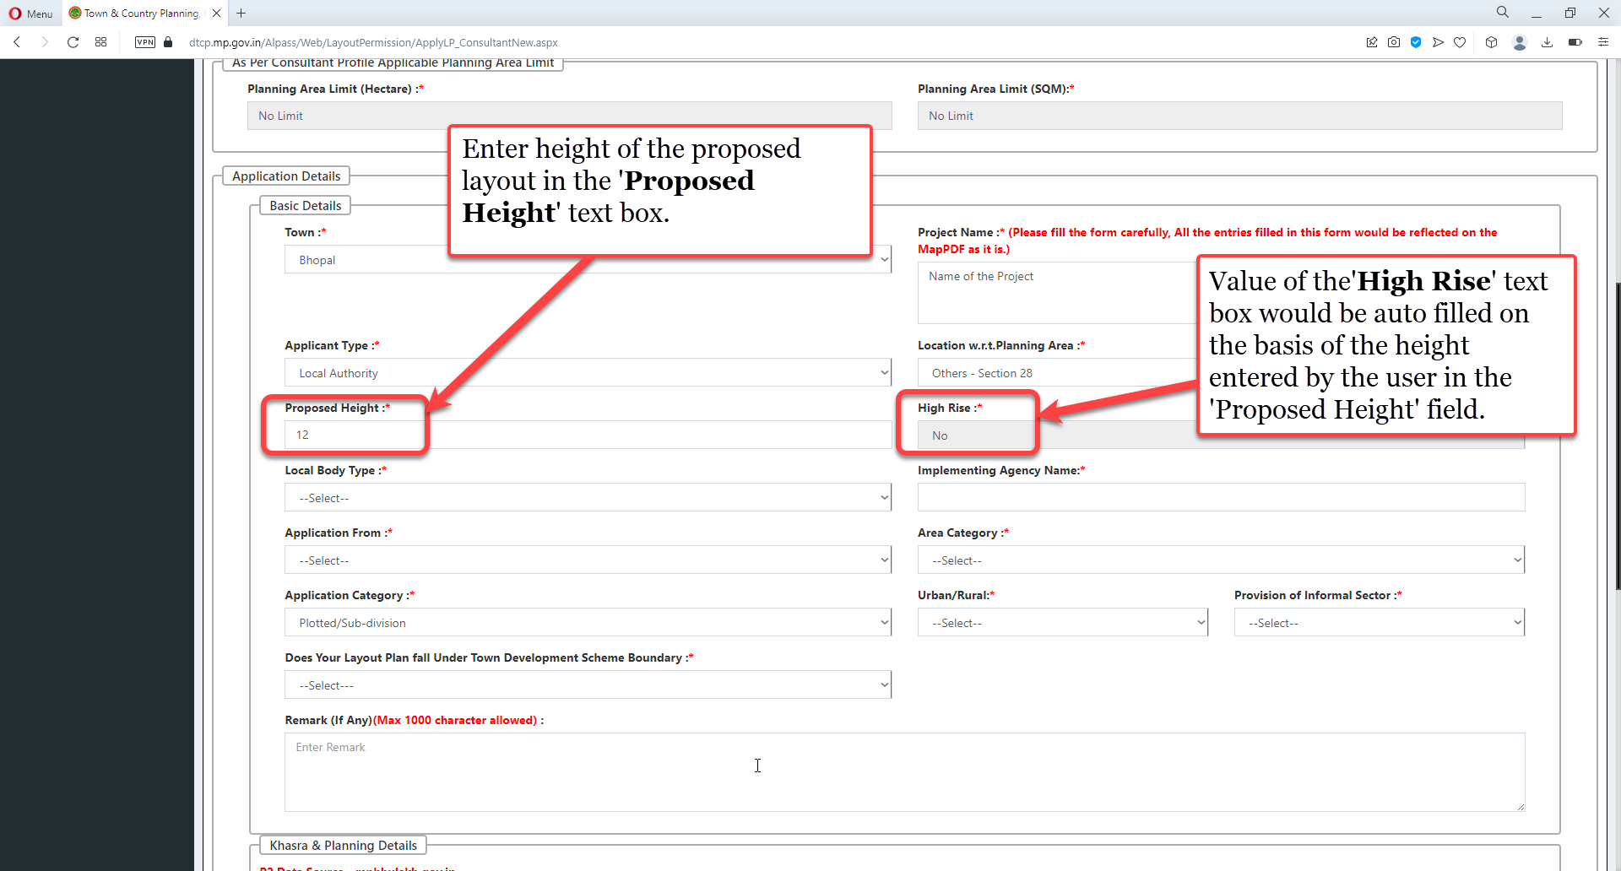
Enter height of the proposed layout in the 'Proposed Height' text box. Value of the 'High Rise' text box would be auto filled on the basis of the height entered by the user in the 'Proposed Height' field

Slide 15
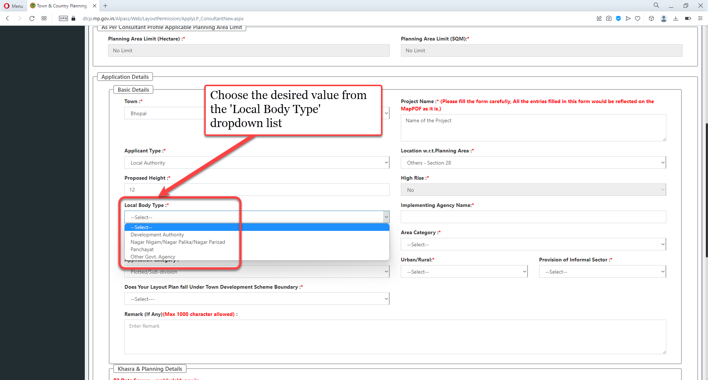
Choose the desired value from the 'Local Body Type' dropdown list

Slide 16
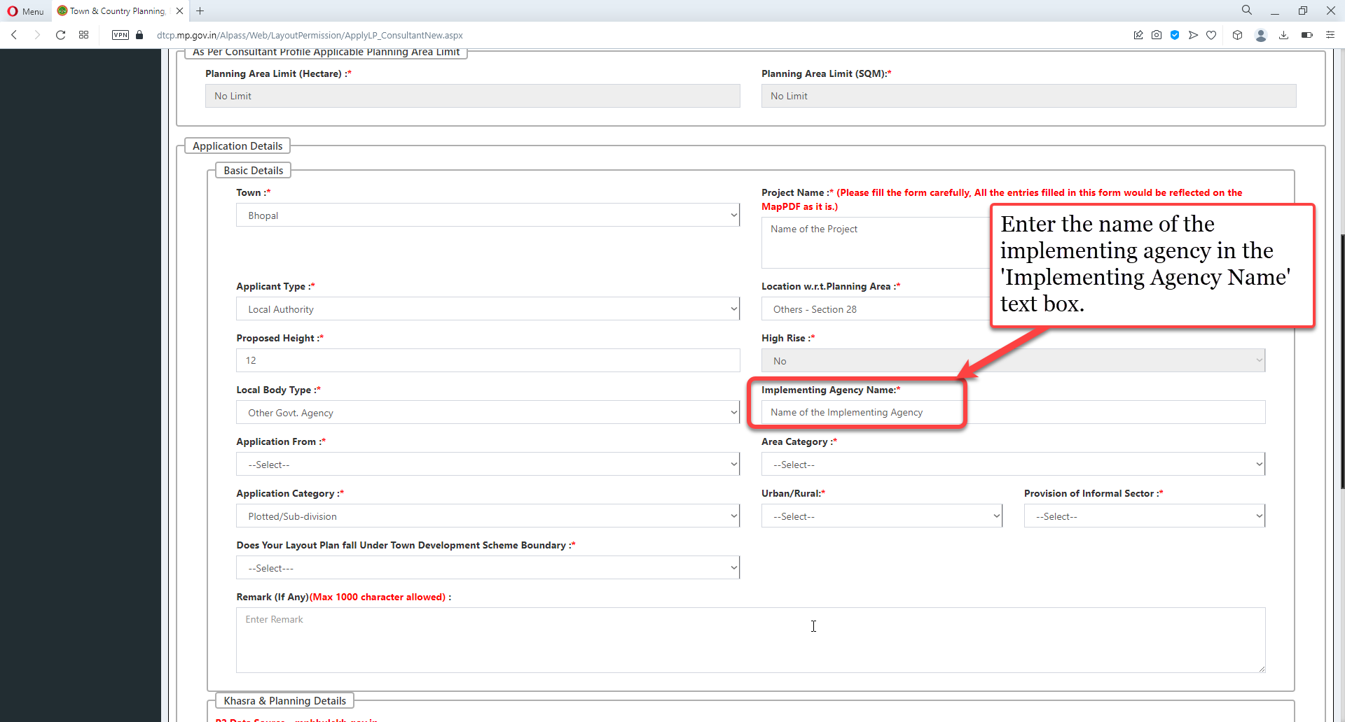
Enter the name of the implementing agency in the 'Implementing Agency Name' text box.

Slide 17
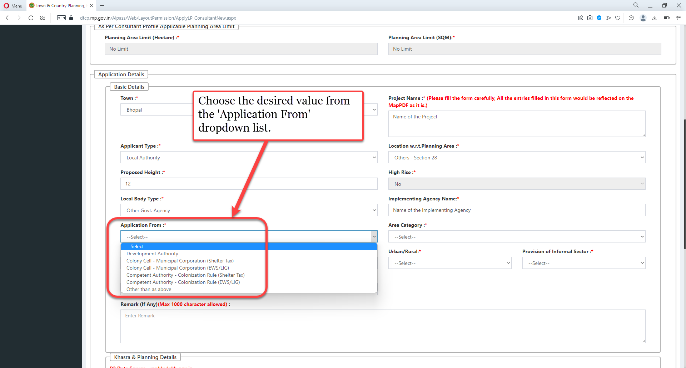
Choose the desired value from the 'Application From' dropdown list.

Slide 18
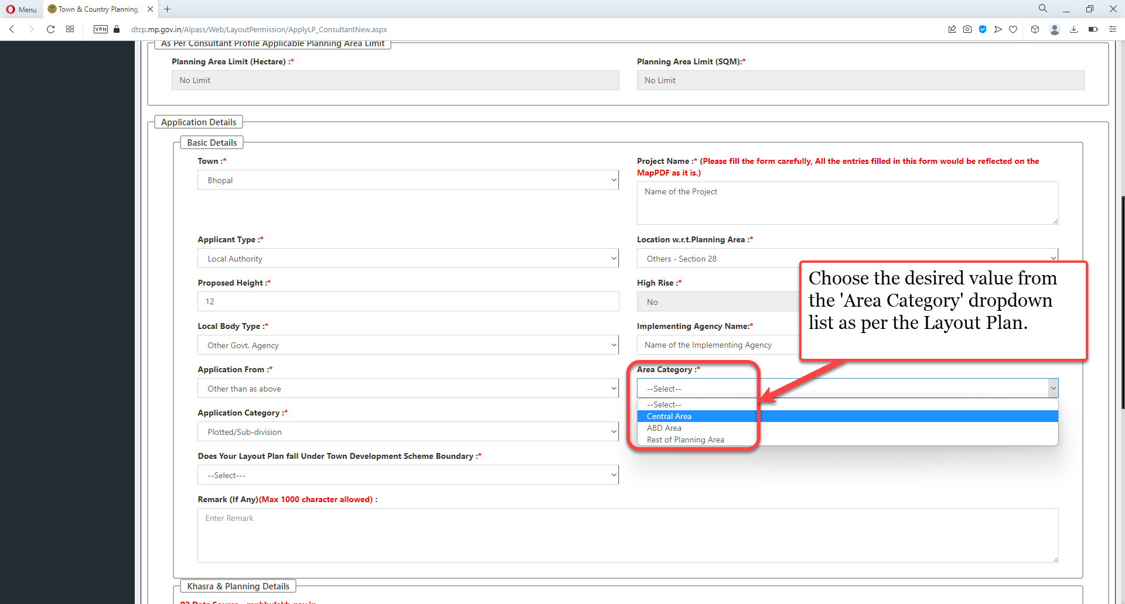
Choose the desired value from the 'Area Category' dropdown list as per the Layout Plan

Slide 19
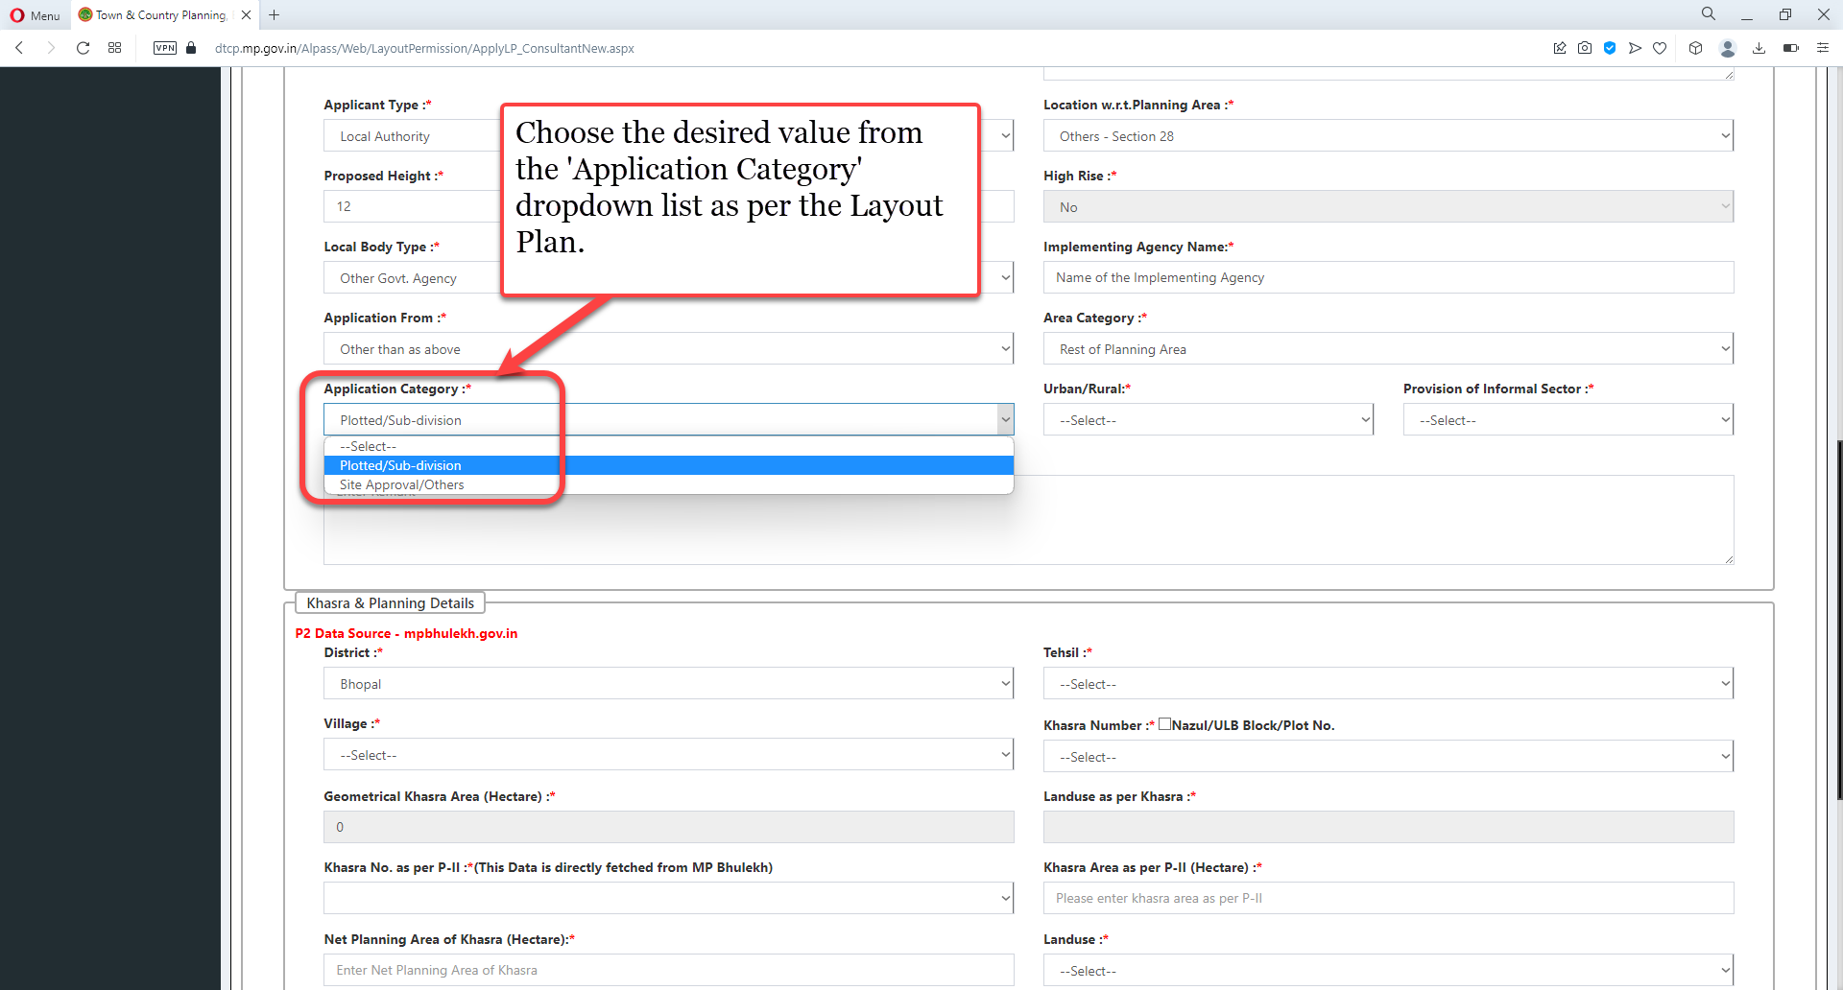
Choose the desired value from the 'Application Category' dropdown list as per the Layout Plan

Slide 20
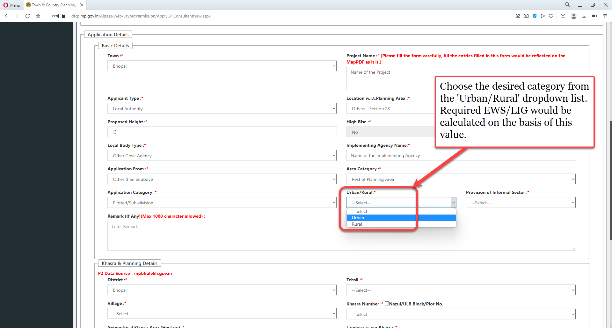
Choose the desired category from the 'Urban/Rural' dropdown list. Required EWS/LIG would be calculated on the basis of this value

Slide 21
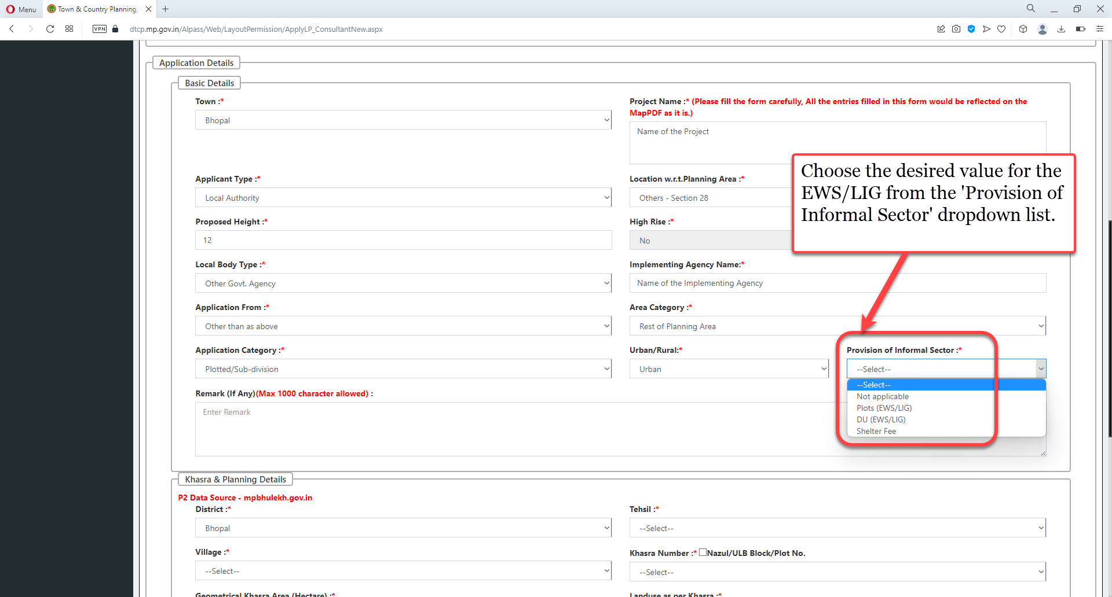
Choose the desired value for the EWS/LIG from the 'Provision of Informal Sector' dropdown list

Slide 22
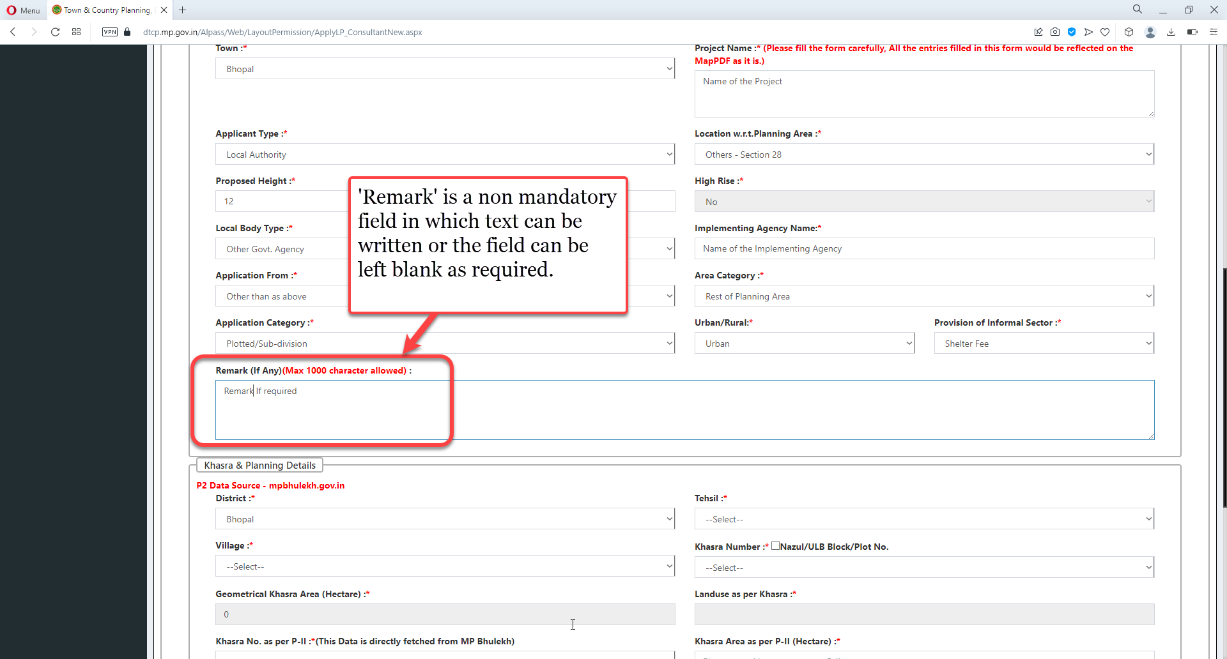
'Remark' is a non-mandatory field in which text can be written or the field can be left blank as required

Slide 23
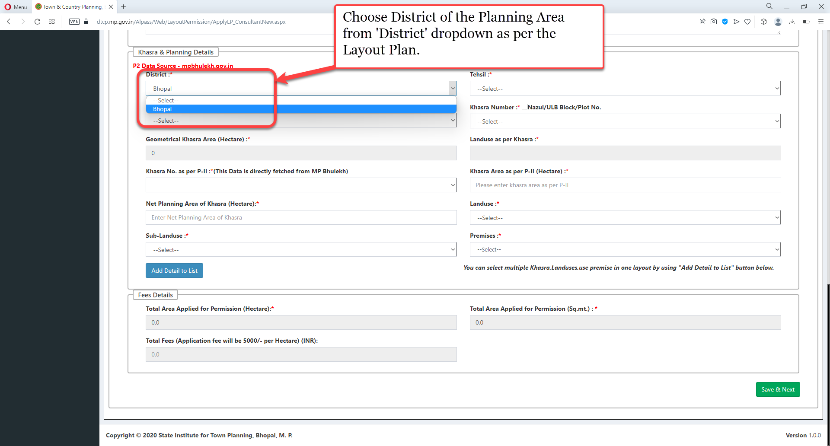
Choose District of the Planning Area from 'District' dropdown as per the Layout Plan.

Slide 24
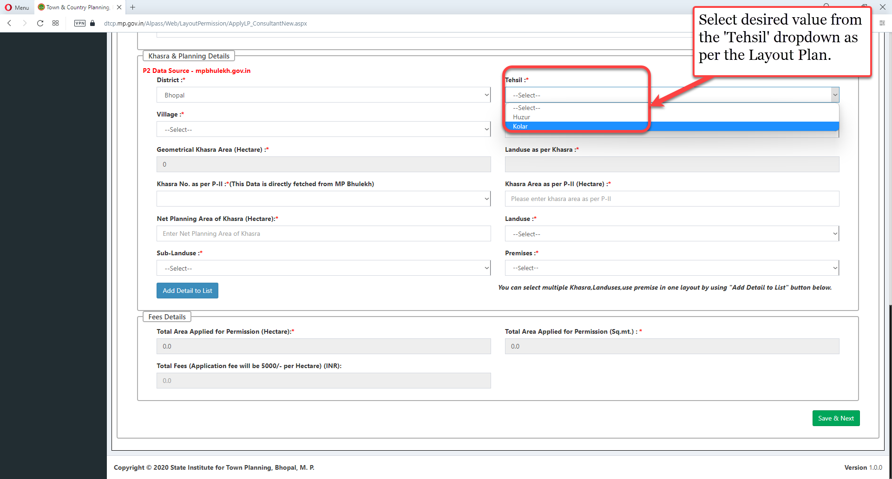
Select desired value from the 'Tehsil' dropdown as per the Layout Plan

Slide 25
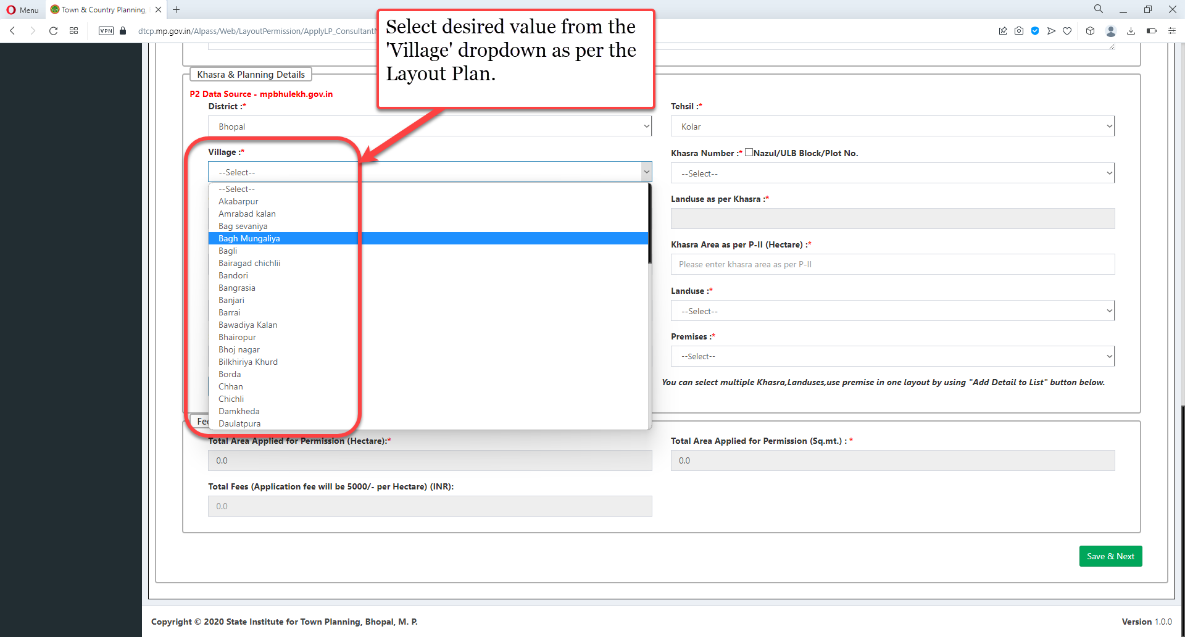
Select desired value from the 'Village' dropdown as per the Layout Plan

Slide 26
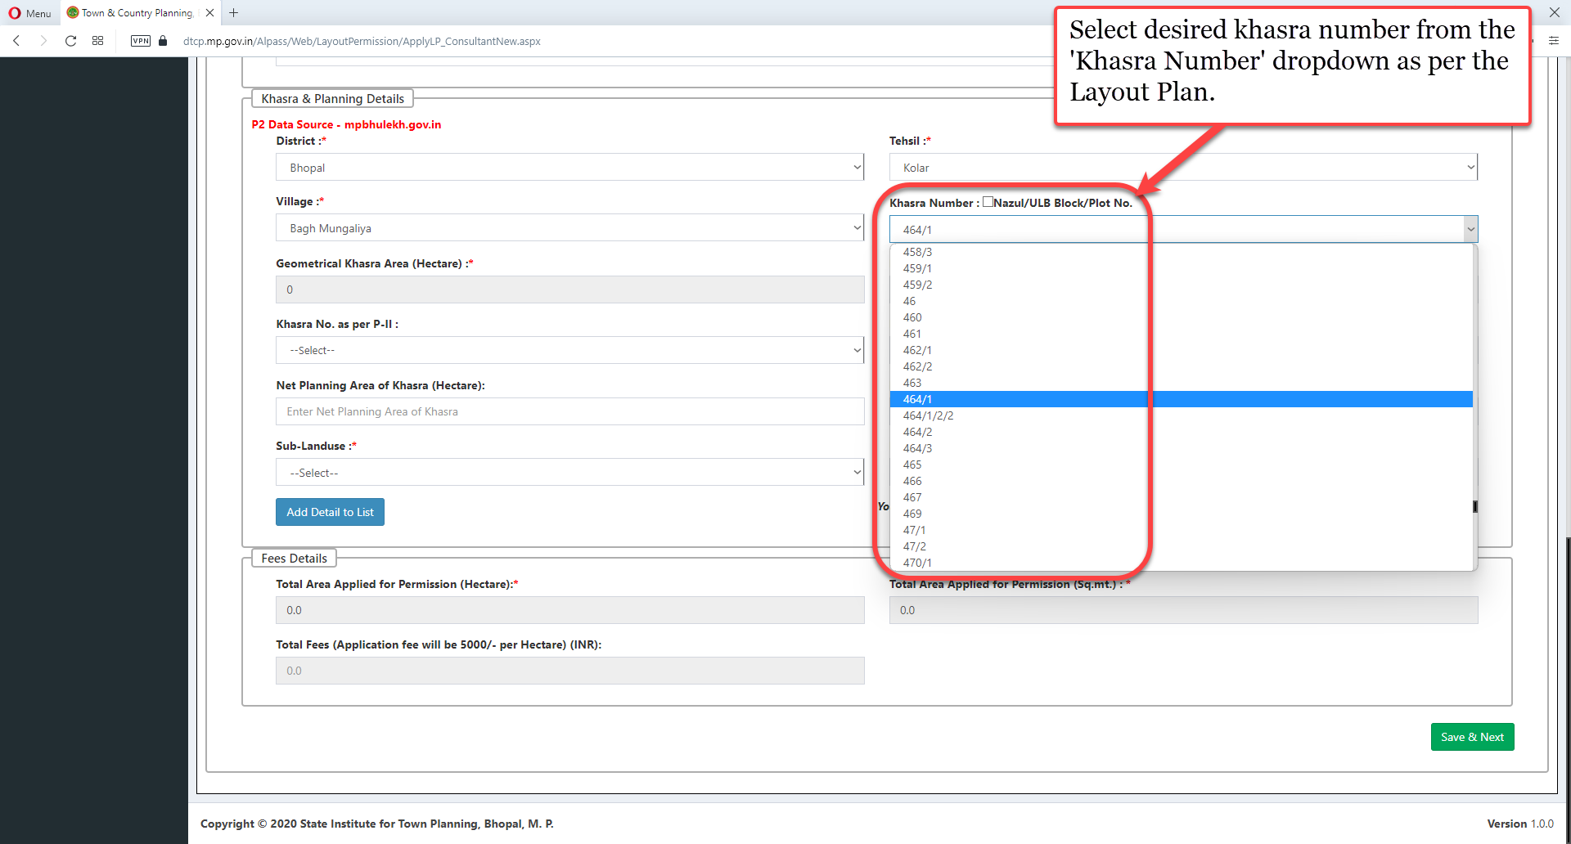
Select desired khasra number from the 'Khasra Number' dropdown as per the Layout Plan

Slide 27
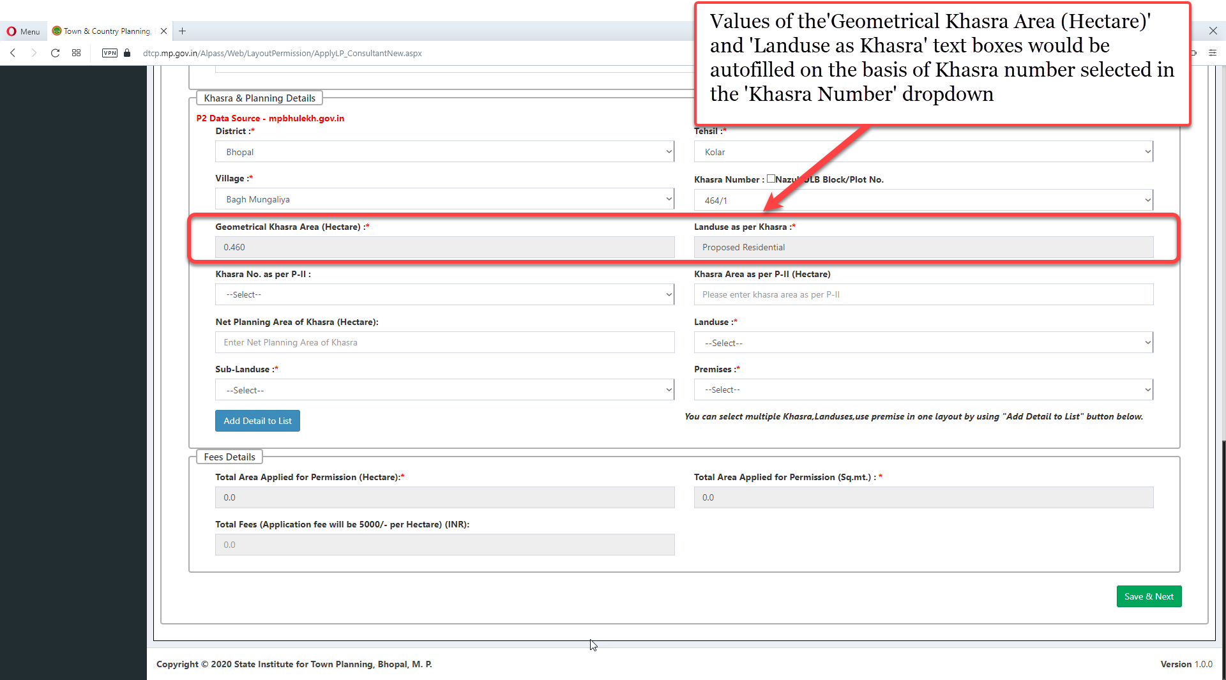
Values of the 'Geometrical Khasra Area (Hectare)' and 'Landuse as Khasra' text boxes would be autofilled on the basis of Khasra number selected in the 'Khasra Number' dropdown

Slide 28
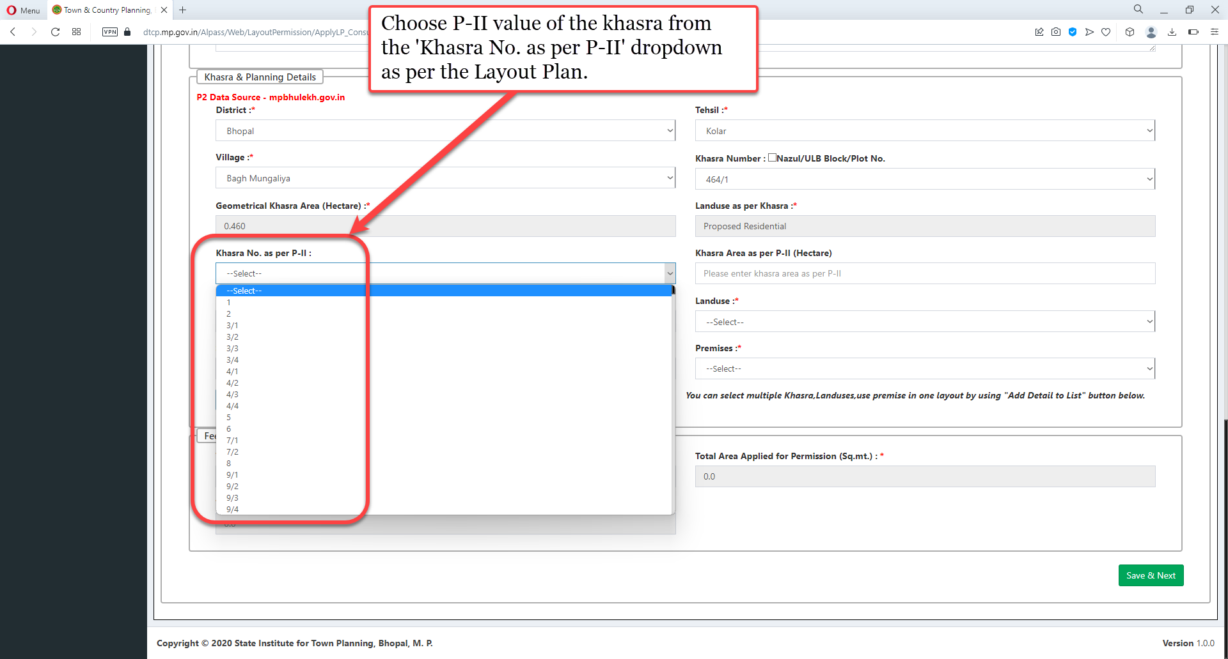
Choose P-II value of the khasra from the 'Khasra No. as per P-II' dropdown as per the Layout Plan.

Slide 29
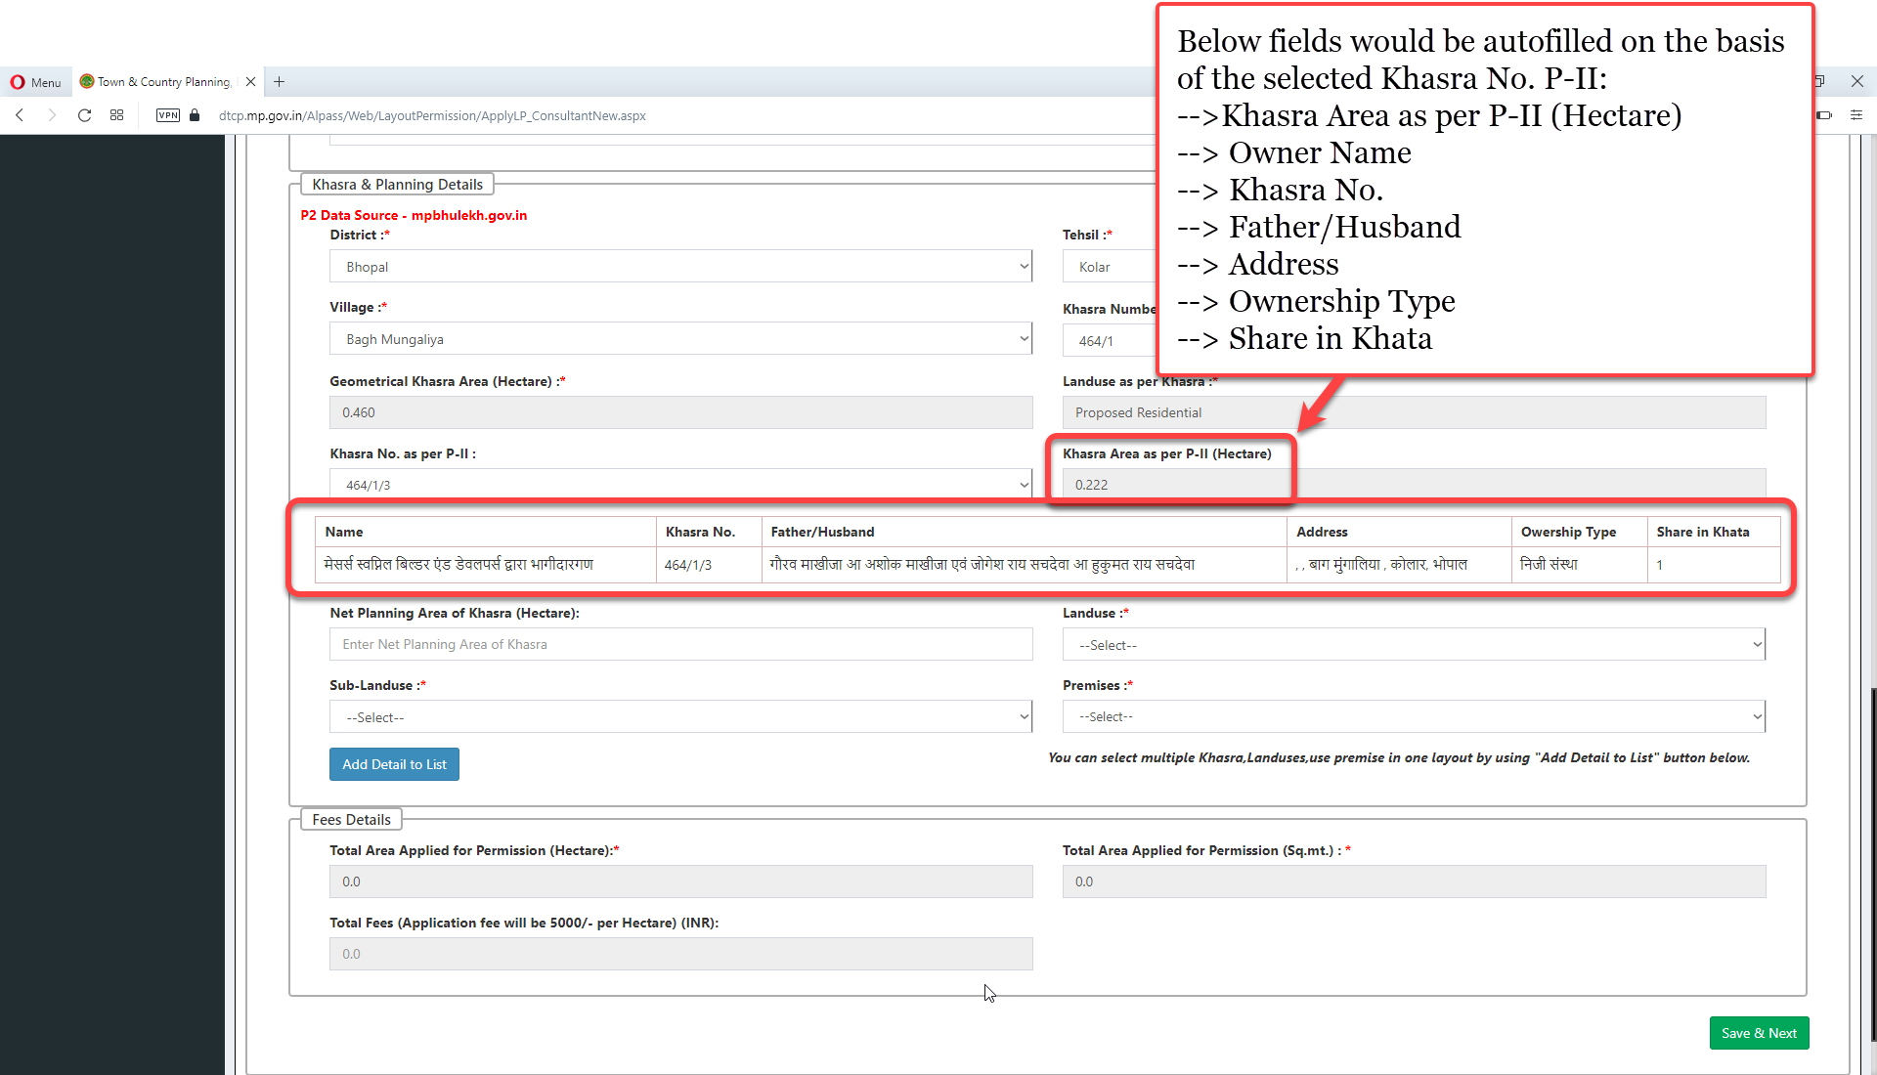
Following fields would be autofilled on the basis of the selected Khasra No. P-II: “Khasra Area as per P-II (Hectare)”, “Owner Name”, “Khasra No.”, “Father/Husband”, “Address”, “Ownership Type”, “Share in Khata”

Slide 30
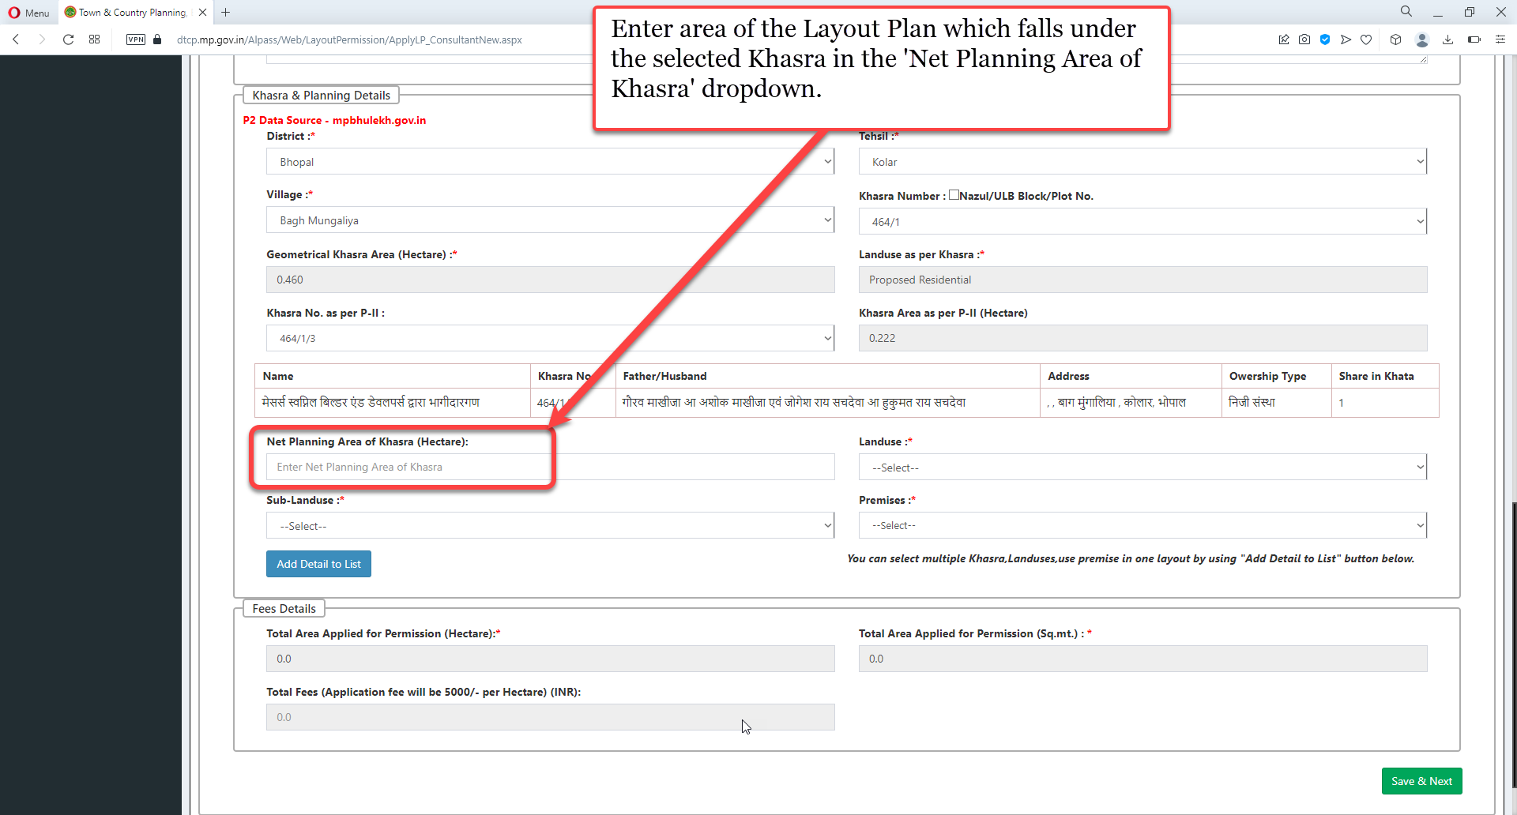
Enter area of the Layout Plan which falls under the selected Khasra in the 'Net Planning Area of Khasra' dropdown.

Slide 31
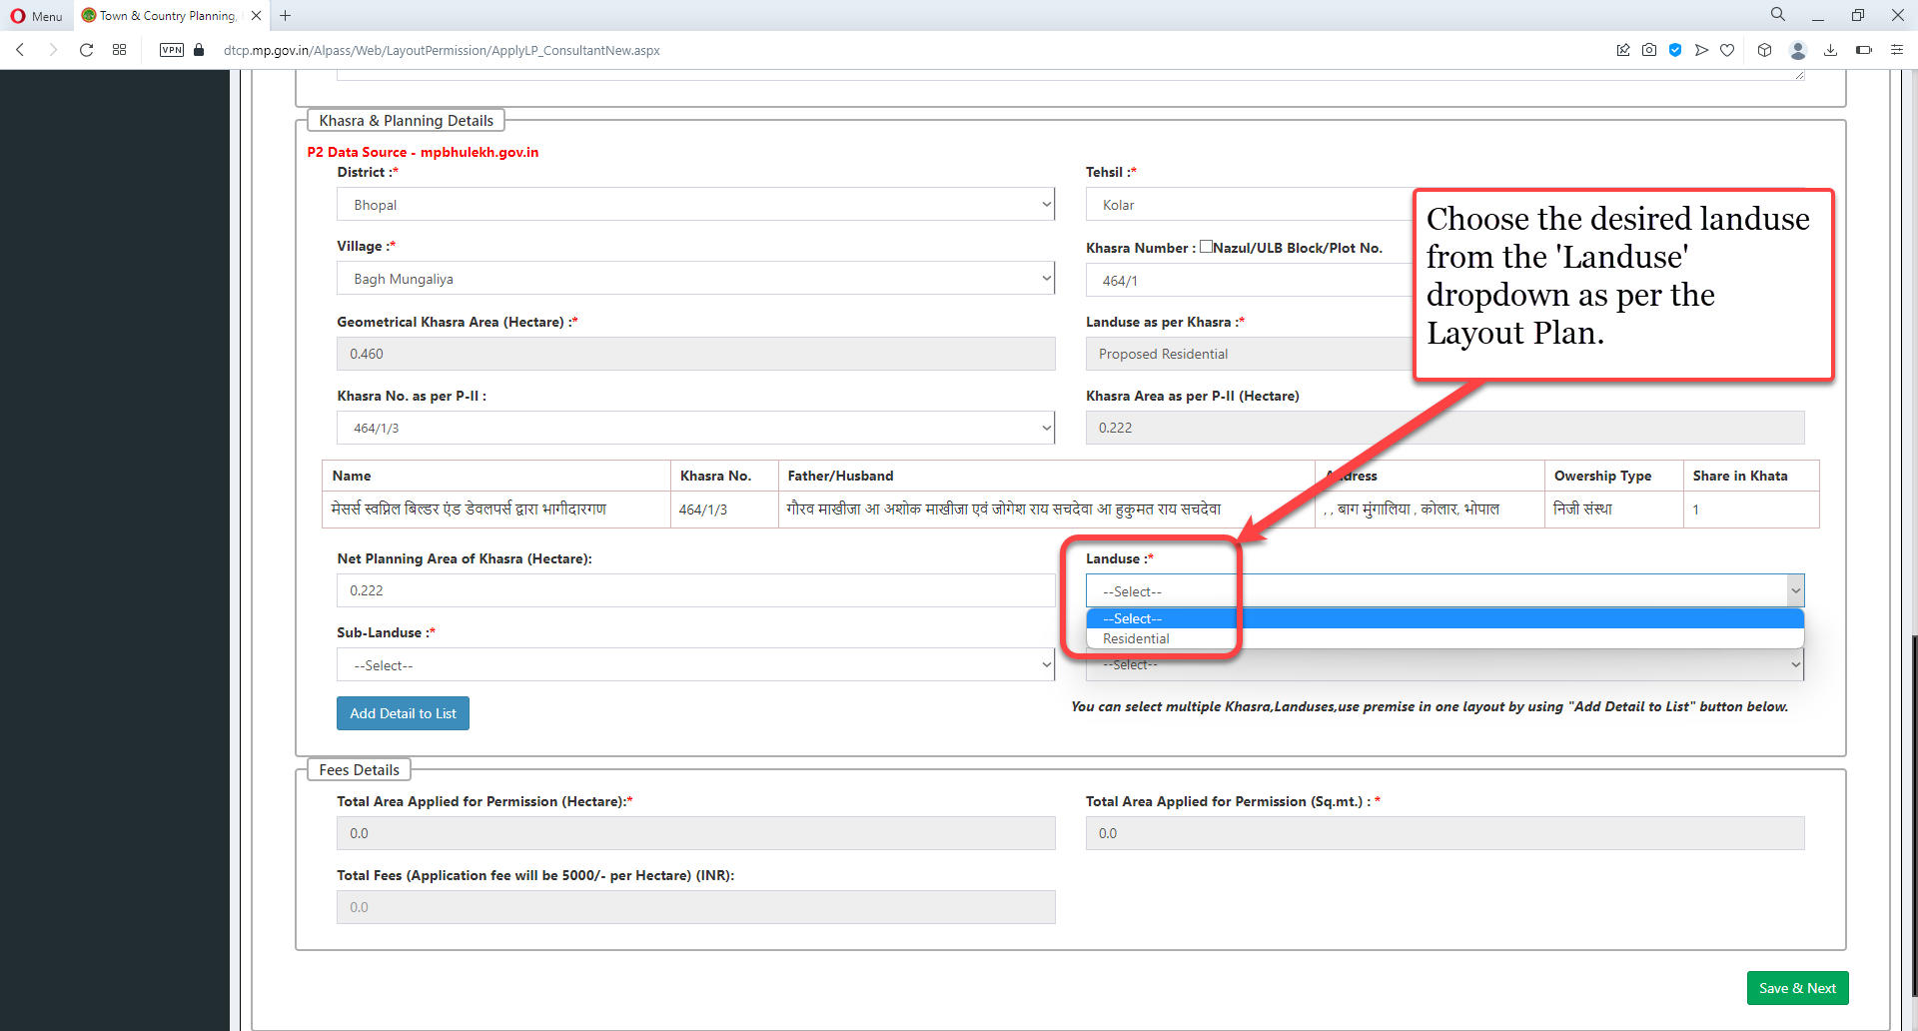
Choose the desired Landuse from the 'Landuse' dropdown as per the Layout Plan

Slide 32
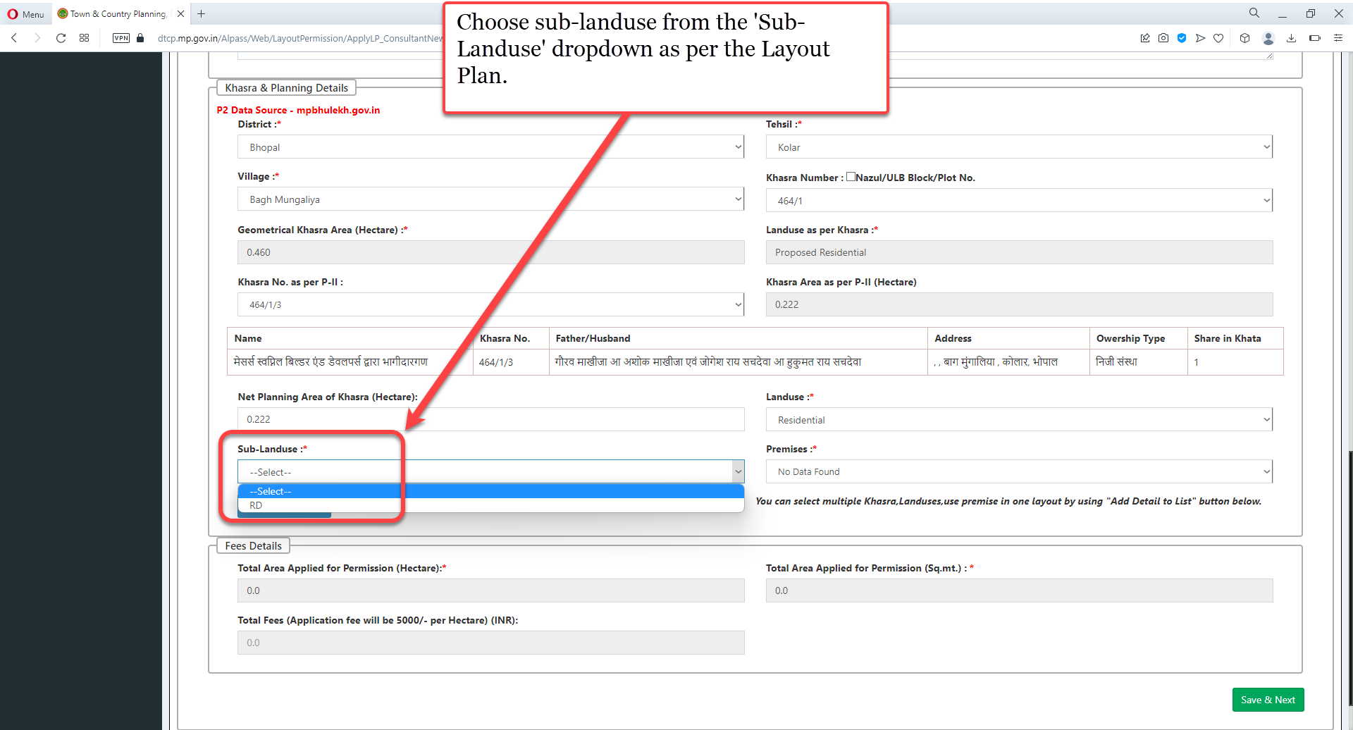
Choose sub-landuse from the 'Sub-Landuse' dropdown as per the Layout Plan

Slide 33
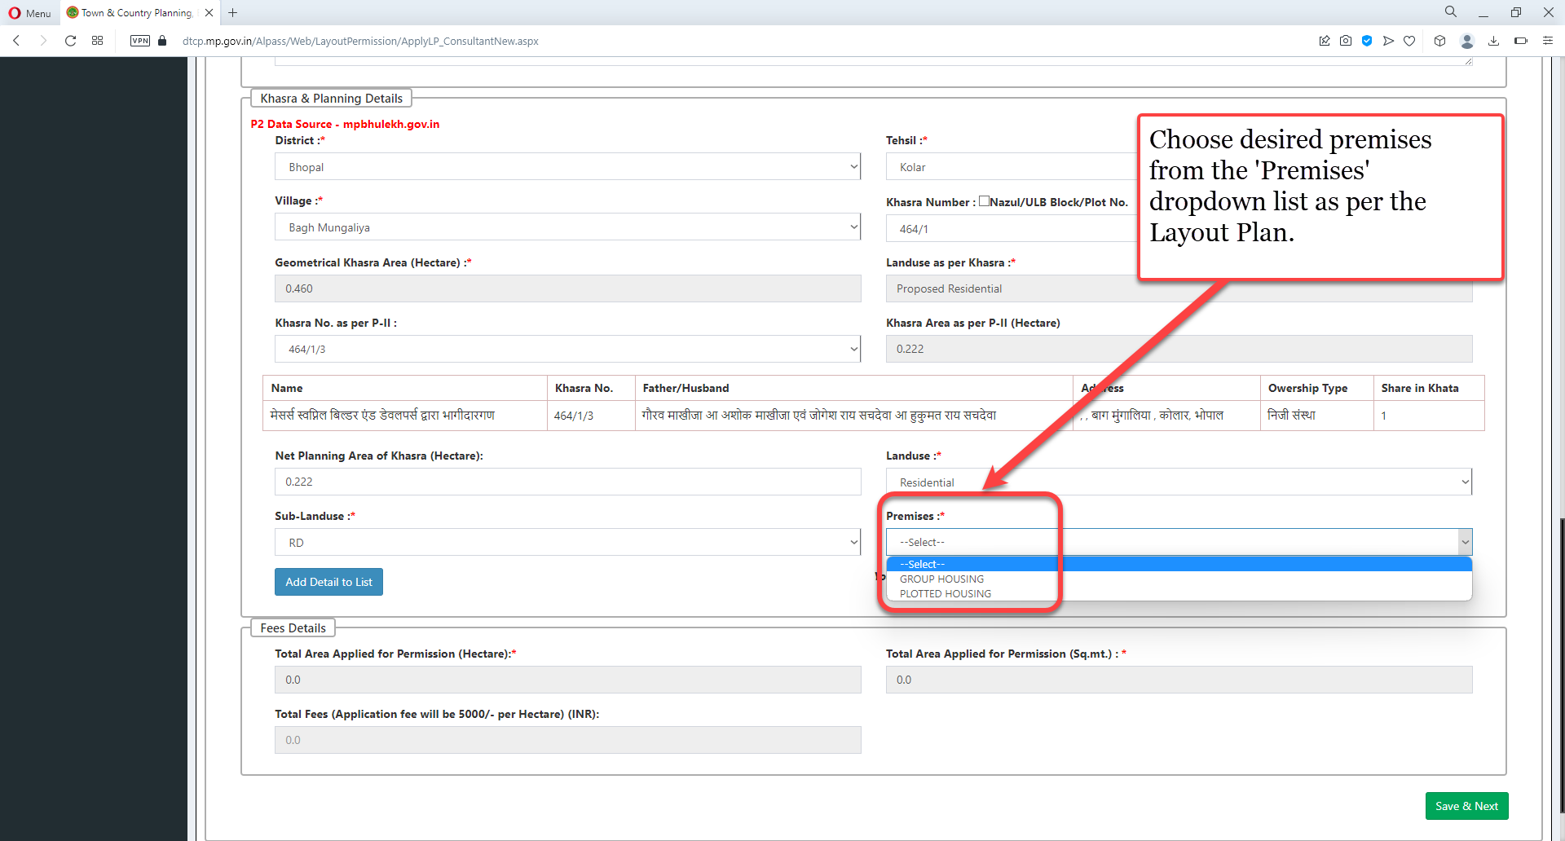
Choose desired premises from the 'Premises' dropdown list as per the Layout Plan

Slide 34
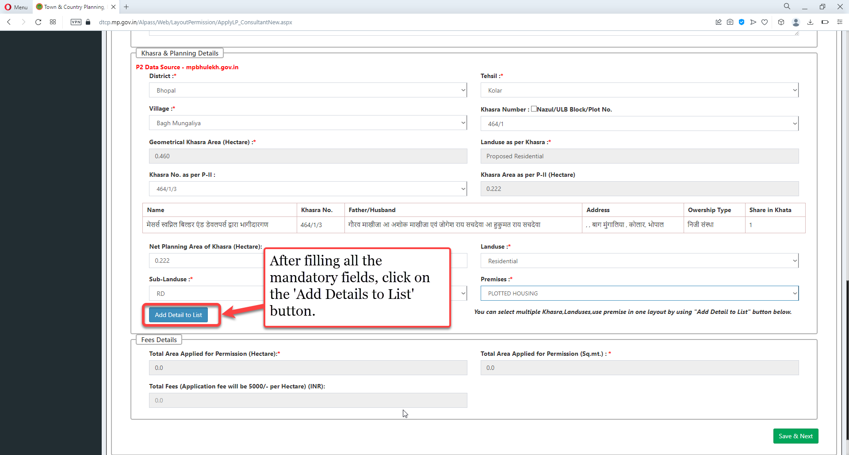
After filling all the mandatory fields, click on the 'Add Details to List' button

Slide 35
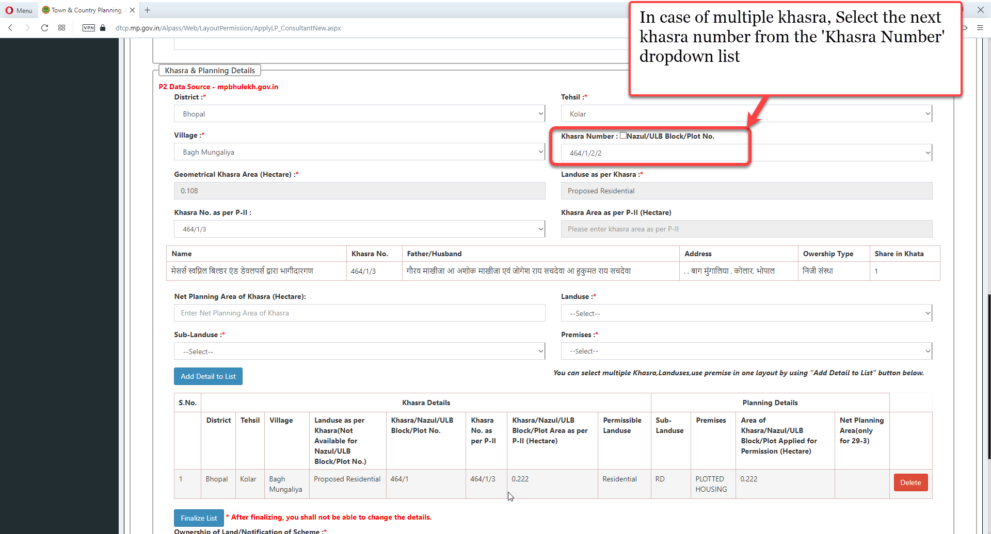
In case of multiple khasra, Select the next khasra number from the 'Khasra Number' dropdown list

Slide 36
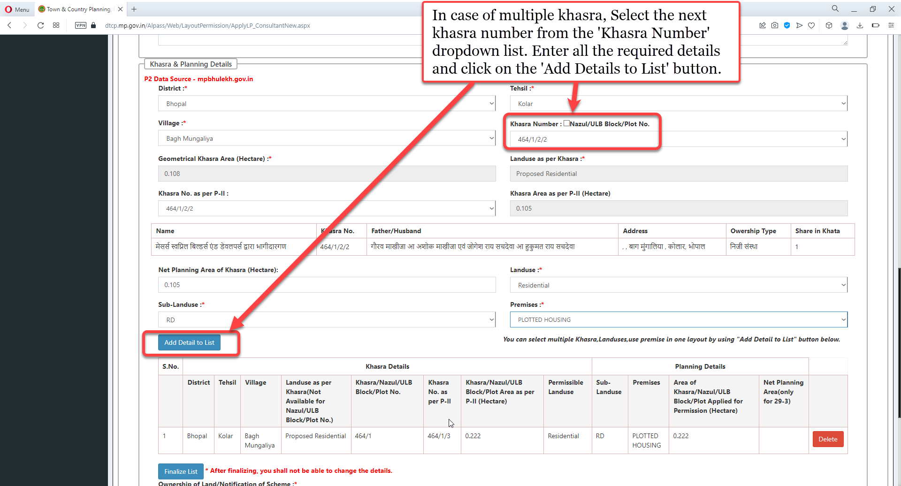
In case of multiple khasra, Select the next khasra number from the 'Khasra Number' dropdown list. Enter all the required details and click on the 'Add Details to List' button

Slide 37
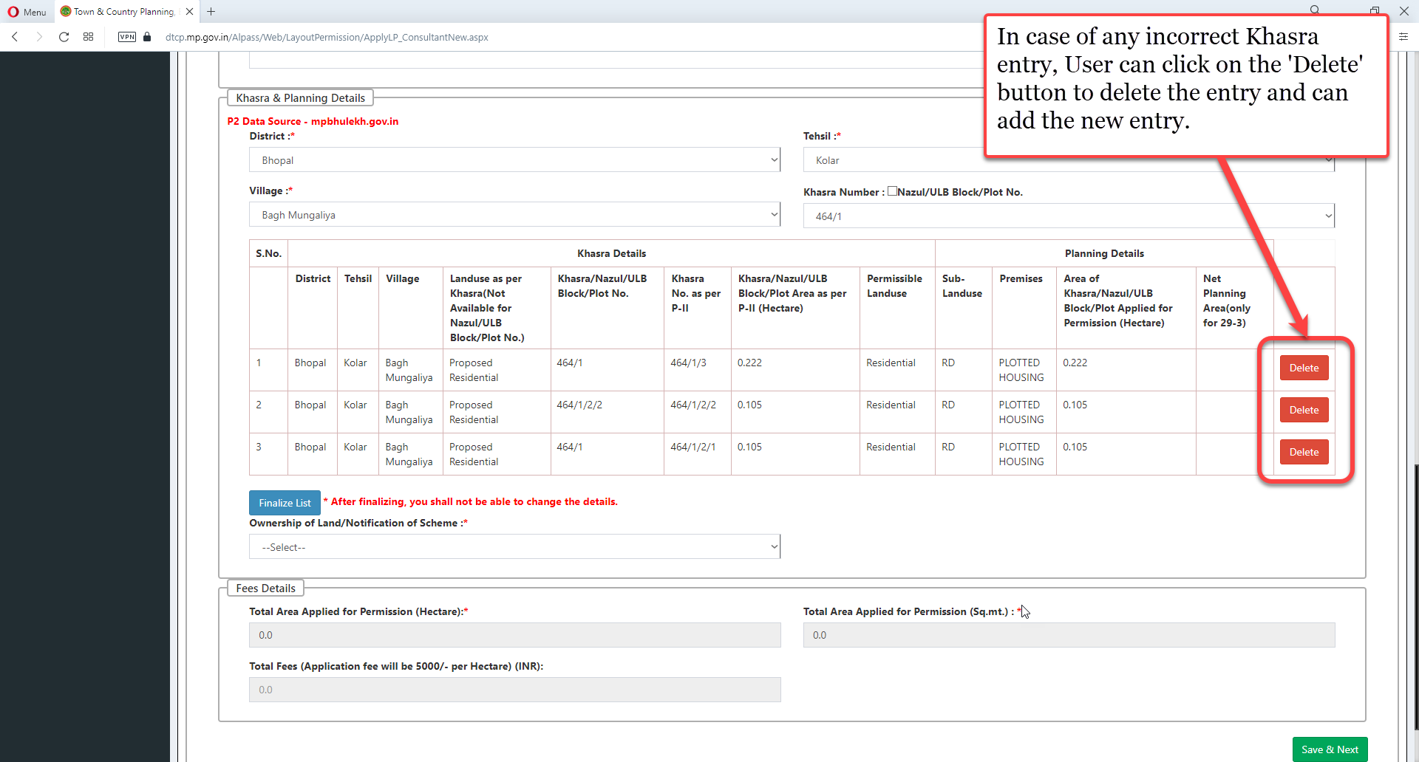
In case of any incorrect Khasra entry, User can click on the 'Delete' button to delete the entry and can add the new entry

Slide 38
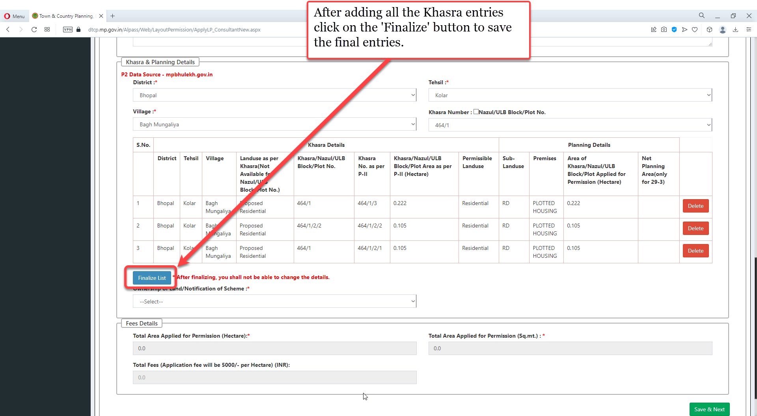
After adding all the Khasra entries click on the 'Finalize' button to save the final entries

Slide 39
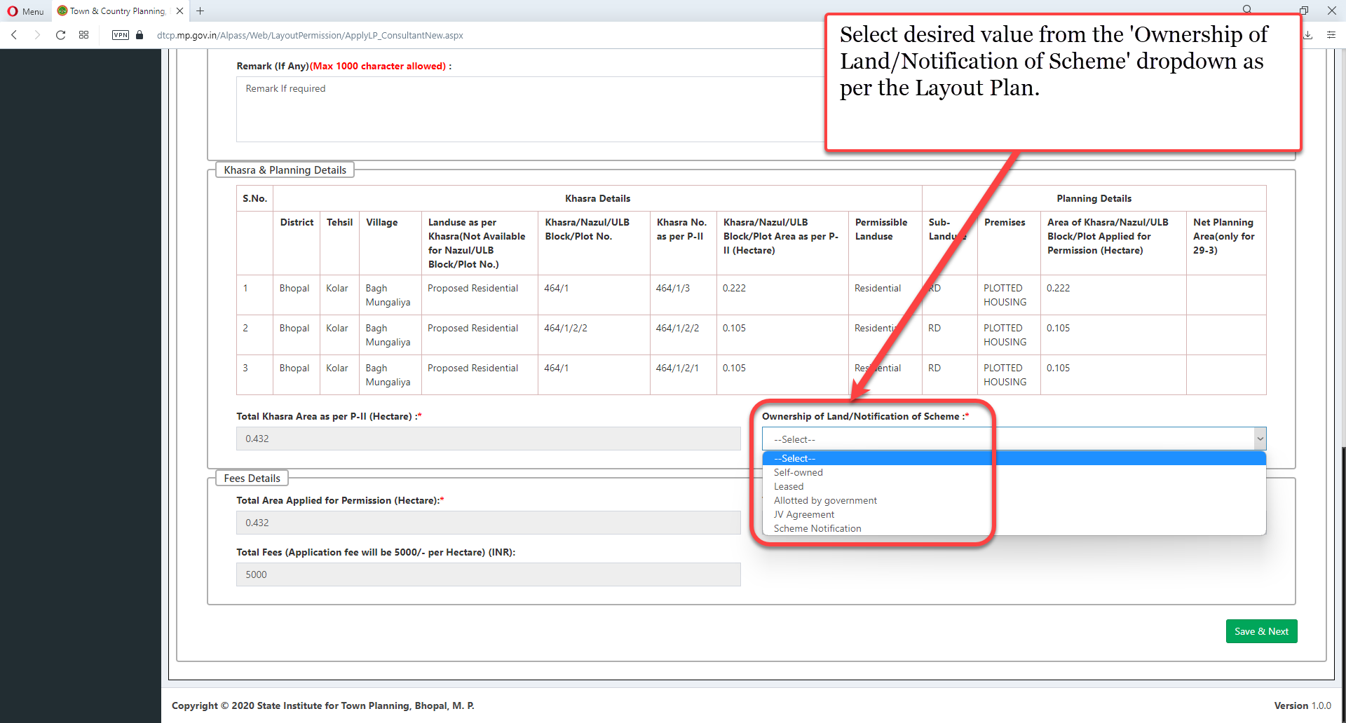
Select desired value from the 'Ownership of Land/Notification of Scheme' dropdown as per the Layout Plan

Slide 40
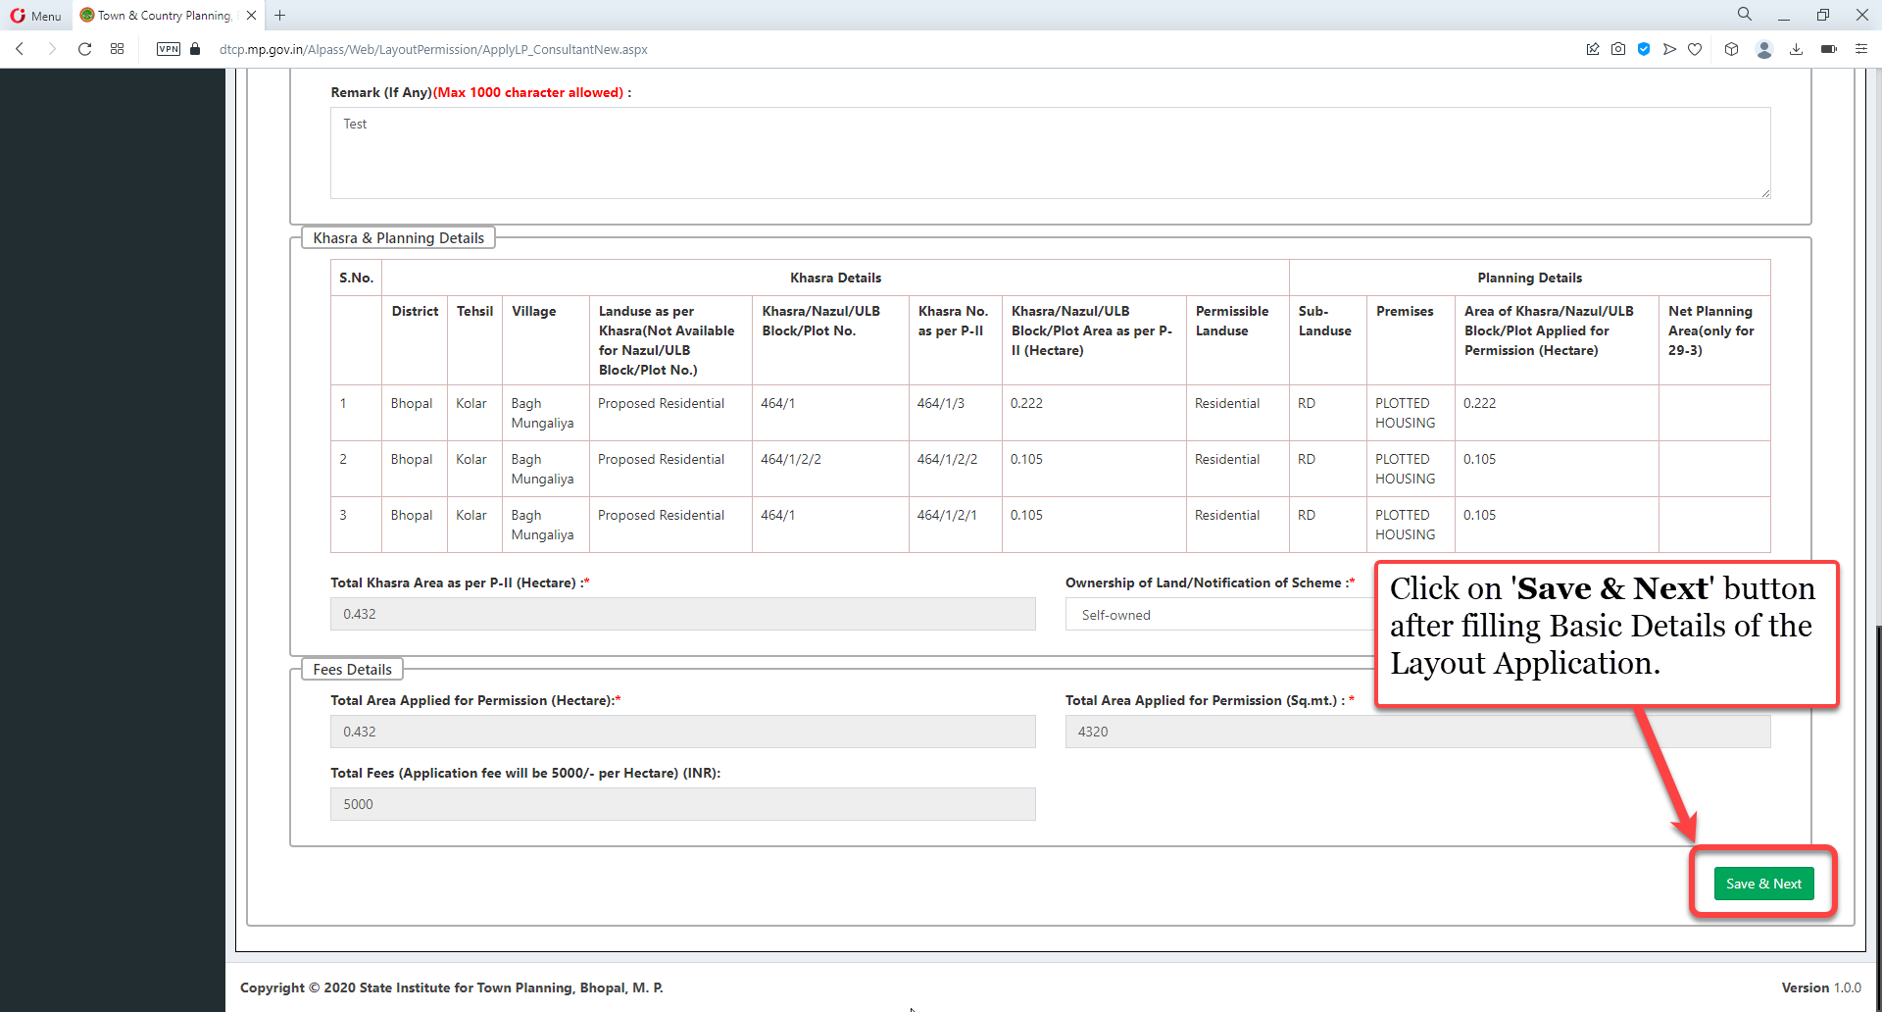
Click on 'Save & Next' button after filling Basic Details of the Layout Application.

Slide 41
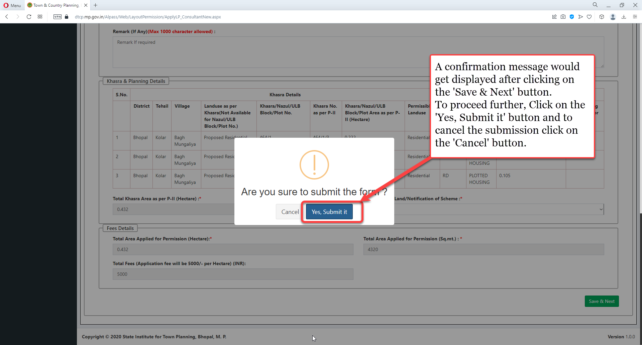
A confirmation message would get displayed after clicking on the 'Save & Next' button.
To proceed further, Click on the 'Yes, Submit it' button and to cancel the submission click on the 'Cancel' button.

Slide 42
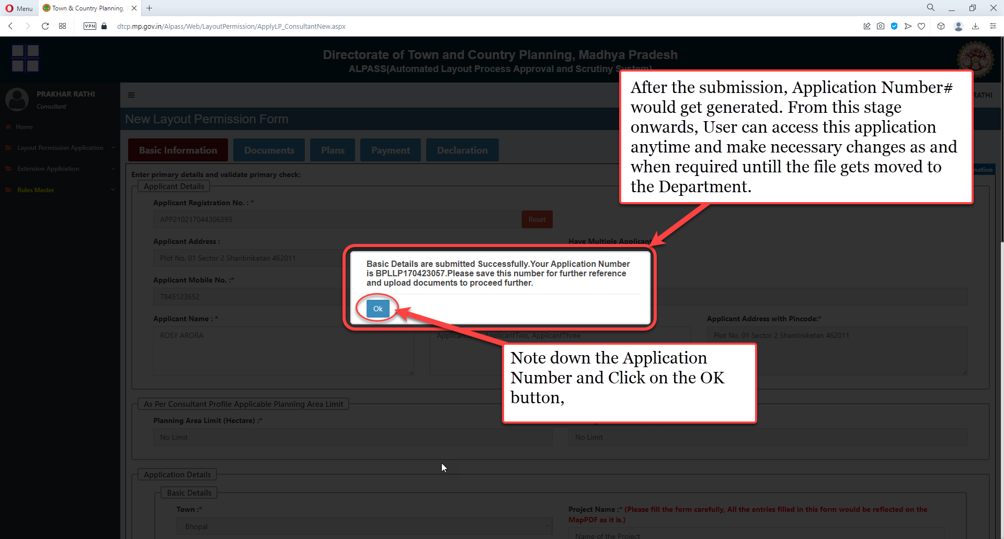
After the submission, Application Number# would get generated. From this stage onwards, User can access this application anytime and make necessary changes as and when required until the file gets moved to the Department. Note down the Application Number and Click on the OK button.

Slide 43
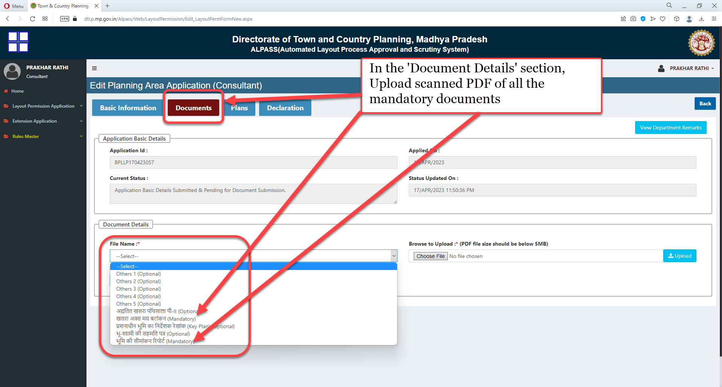
In the 'Document Details' section, Upload scanned PDF of all the mandatory documents

Slide 44
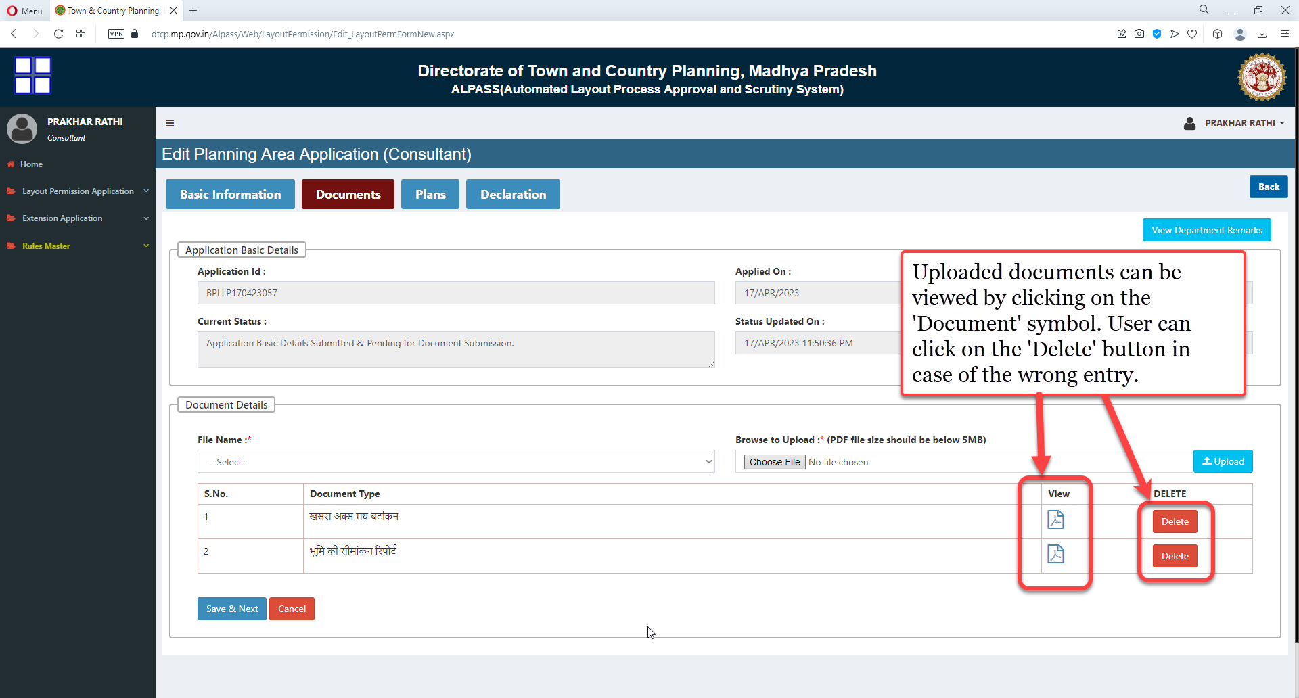
Uploaded documents can be viewed by clicking on the 'Document' symbol. User can click on the 'Delete' button in case of the wrong entry

Slide 45
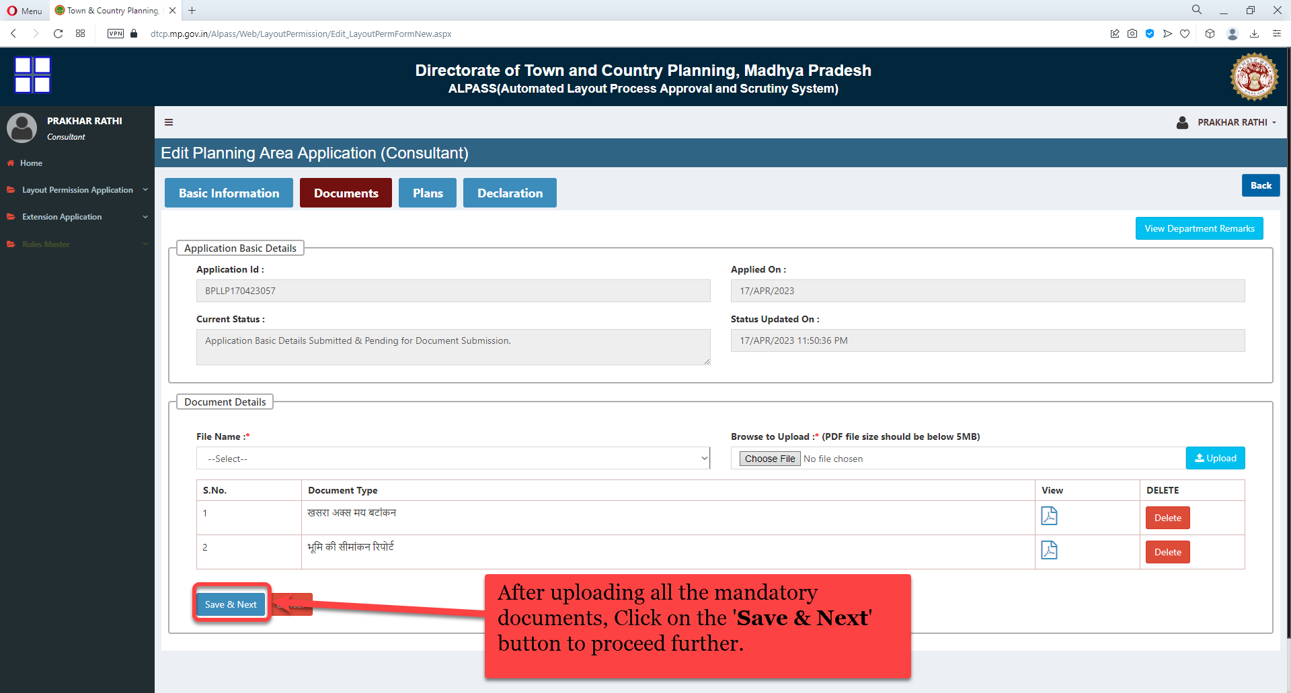
After uploading all the mandatory documents, Click on the 'Save & Next' button to proceed further.

Slide 46
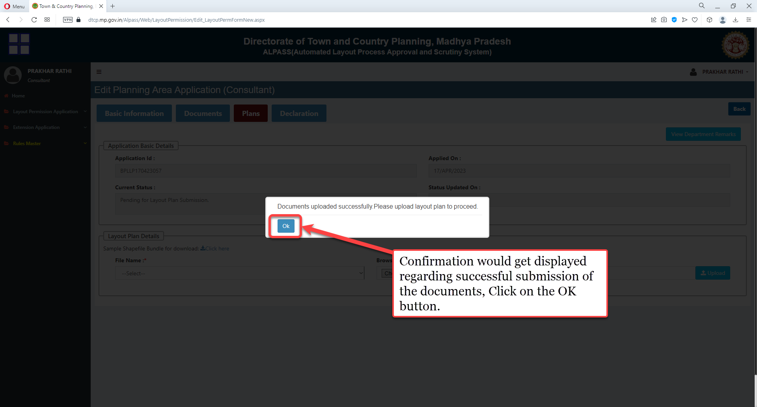
Confirmation would get displayed regarding successful submission of the documents, Click on the OK button

Slide 47
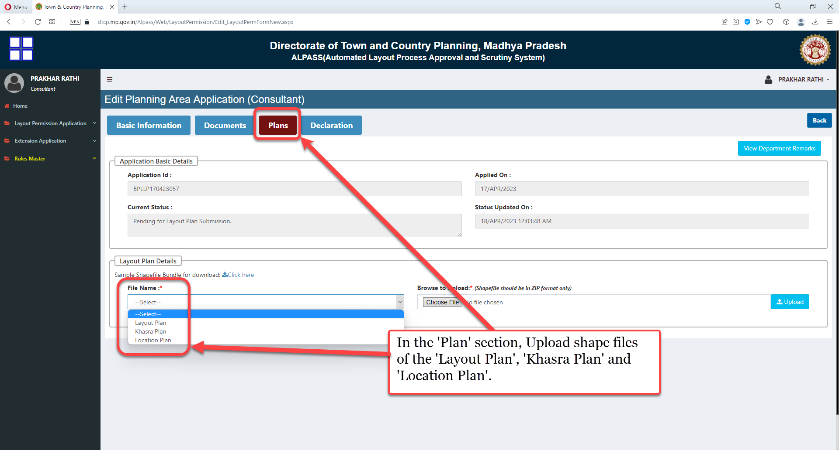
In the 'Plan' section, Upload shape files of the 'Layout Plan', 'Khasra Plan' and 'Location Plan'.

Slide 48
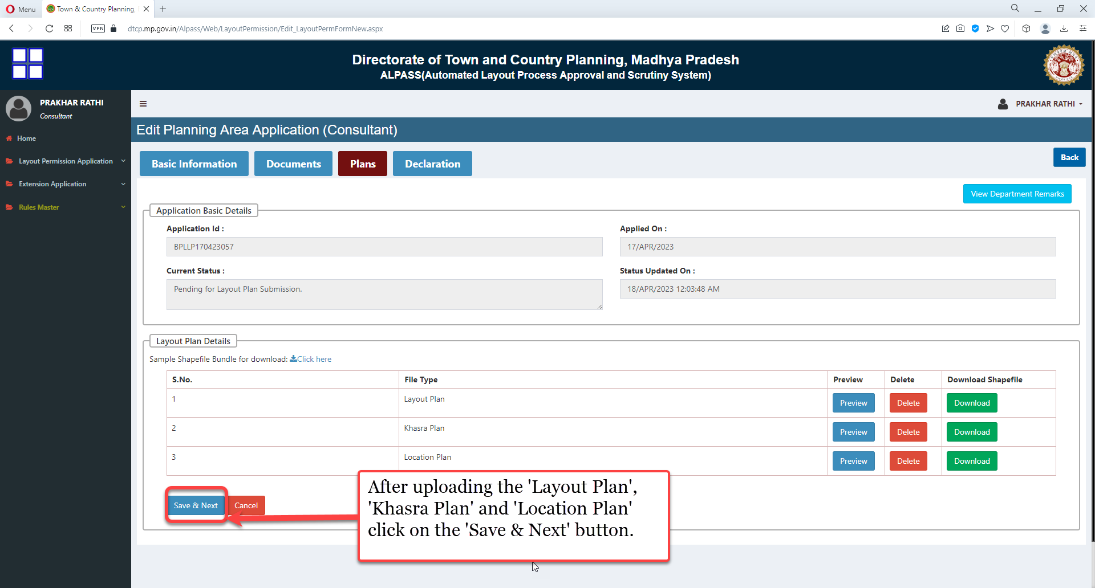
After uploading the 'Layout Plan', 'Khasra Plan' and 'Location Plan' click on the 'Save & Next' button

Slide 49
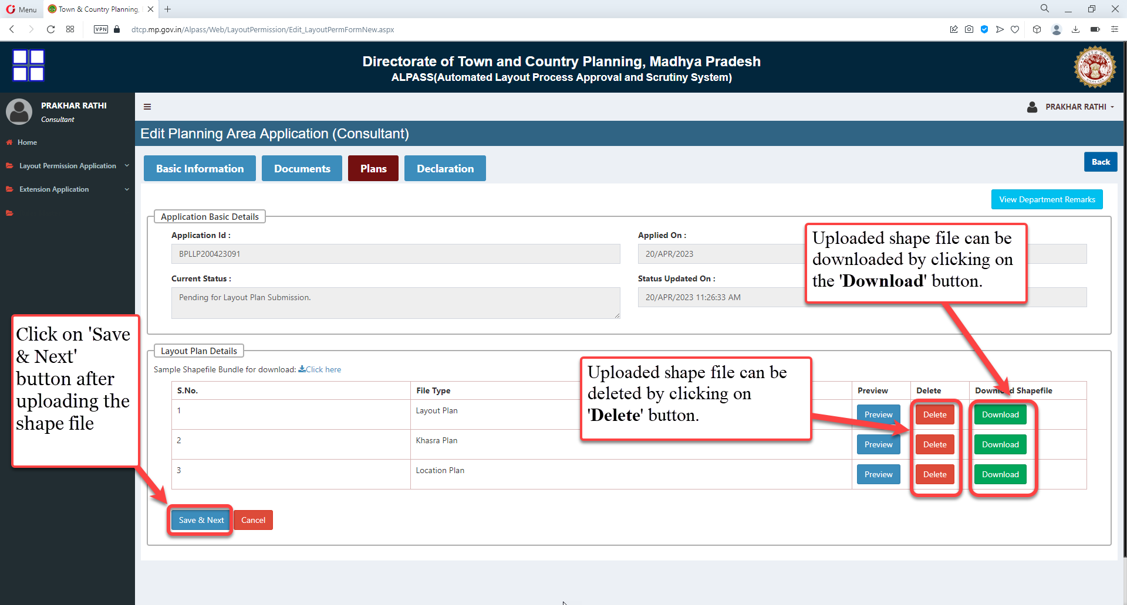
Uploaded shape file can be downloaded by clicking on the 'Download' button. Uploaded shape file can be deleted by clicking on 'Delete' button. Click on 'Save & Next' button after uploading shape file

Slide 50
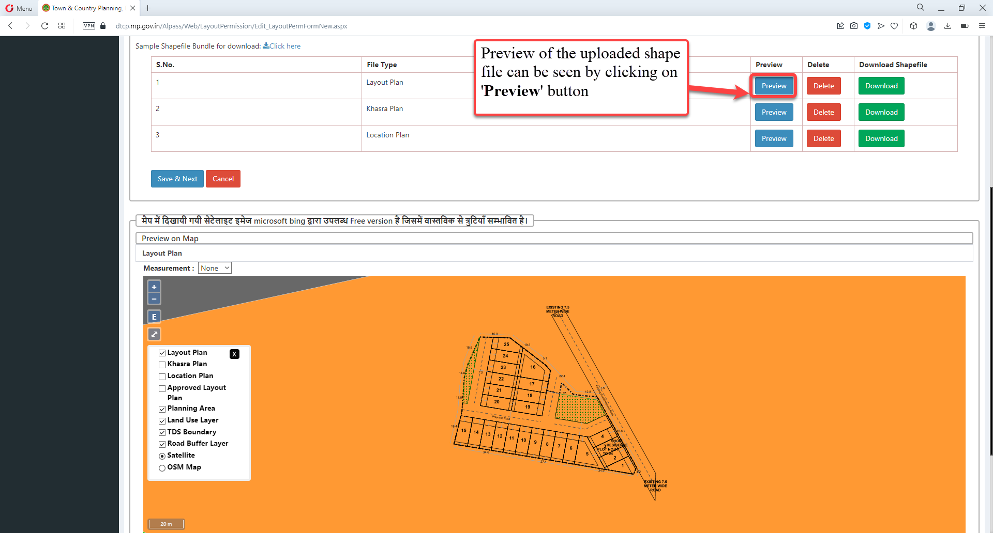
Preview of the uploaded shape file can be seen by clicking on 'Preview' button

Slide 51
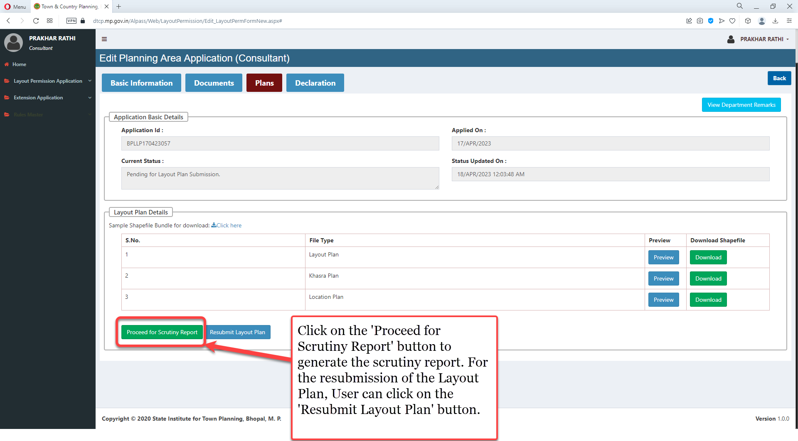
Click on the 'Proceed for Scrutiny Report' button to generate the scrutiny report. For the resubmission of the Layout Plan, User can click on the 'Resubmit Layout Plan' button

Slide 52
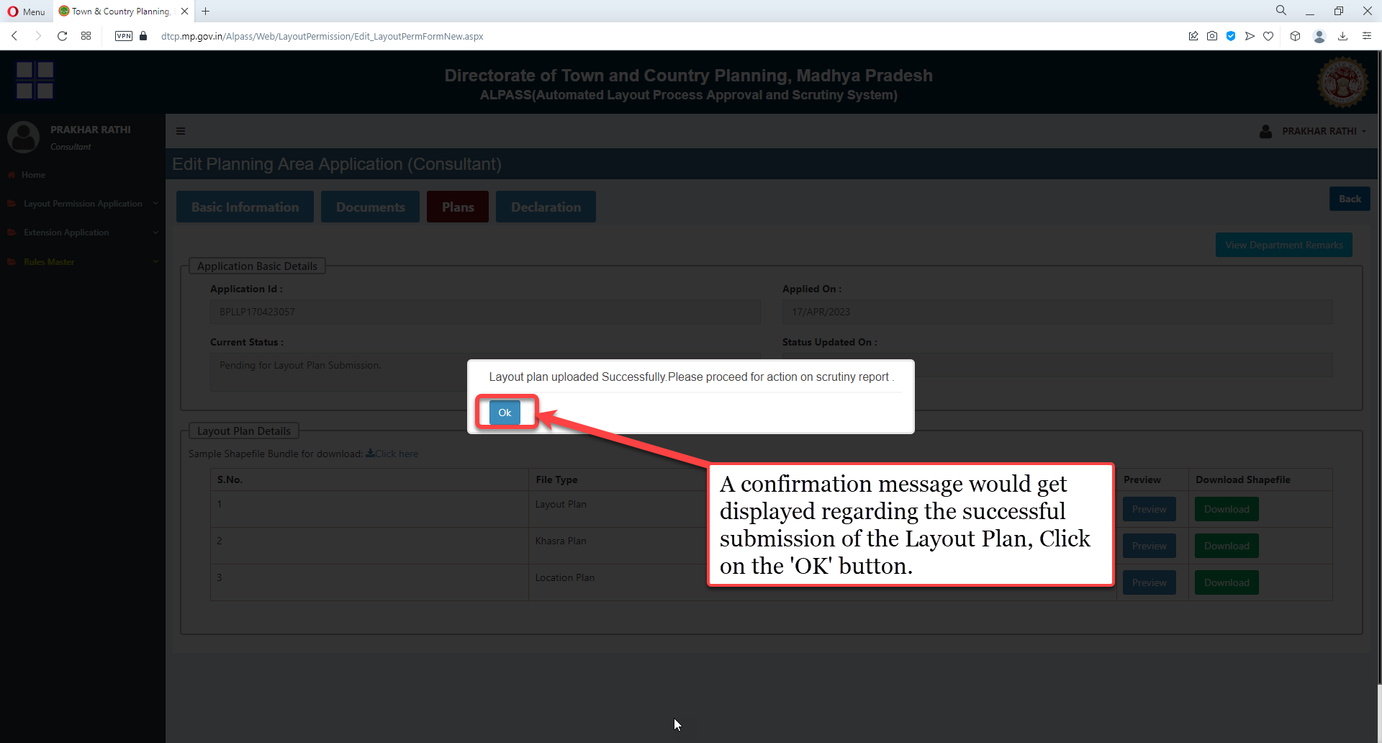
A confirmation message would get displayed regarding the successful submission of the Layout Plan, Click on the 'OK' button

Slide 53

User can click on the document icon to view the 'Scrutiny Report'
After viewing the scrutiny report, If user wants to make changes in the Layout Plan and resubmit it then user can click on the 'Re-Submit Layout Plan' button.
If user wants to proceed further without resubmission of the Layout Plan then user can click on the 'Agree & Proceed to Next Step' button

Slide 54

This is how scrutiny report lools like:

Slide 55

After the scrutiny generation, MapPDF would be generated automatically with the name 'Layout Permission Plan(MapPDF)' which can be accessed in the 'Auto Generated Documents' section.

Slide 56

This is how Auto-generated MapPDF looks like:

Slide 57

Click on 'Agree & Proceed to Next Step' button to proceed further.

Slide 58

A pop-up message would get displayed, Click on the 'OK' button.
Application would be sent to the Applicant's console for the consent. Application would be forwarded to the Department after 'Applicant's consent using the OTP sent on his/her mobile number

